Slide 1

Typical Finnish everyday food
"EU LLP Comenius project:
Sharing is Learning"
Recipes and pictures by Mika, Iina, Joona, Linda, Lotta, Milla

Slide 2
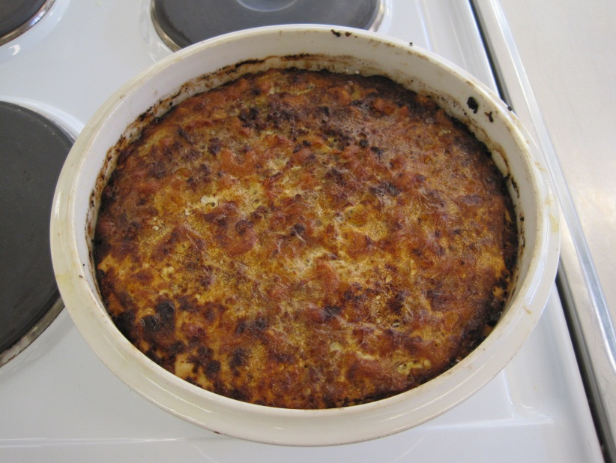
Macaroni casserole (4 persons)
Ingredients:
5 dl macaroni
400 g minced meat (beef or mixed beef and pork)
1 onion
1-2 tsp salt
1 tsp red pepper powder
½ tsp black pepper
3 eggs
7 dl milk (lactose-free)

Slide 3
Instructions
Preheat the oven to 200°C.
Boil the water. Add the macaroni. Cook for approximately 10 minutes.
Peel and chop the onion.
Fry the onion and the minced meat in a pan. Mix the macaroni and the meat in a casserole.
Mix the milk, eggs, salt and spices in a bowl. Pour the eggmilk over the mixed macaroni and meat.
Bake in an oven for 1 hour.

Slide 4
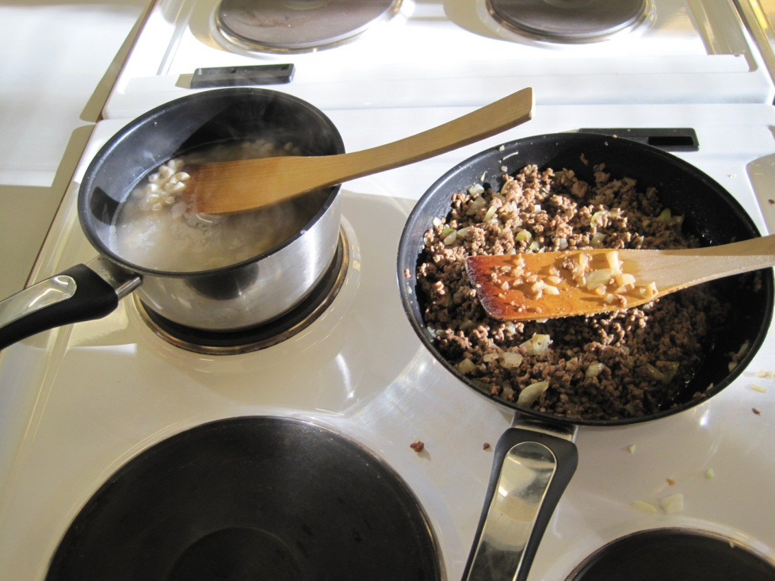
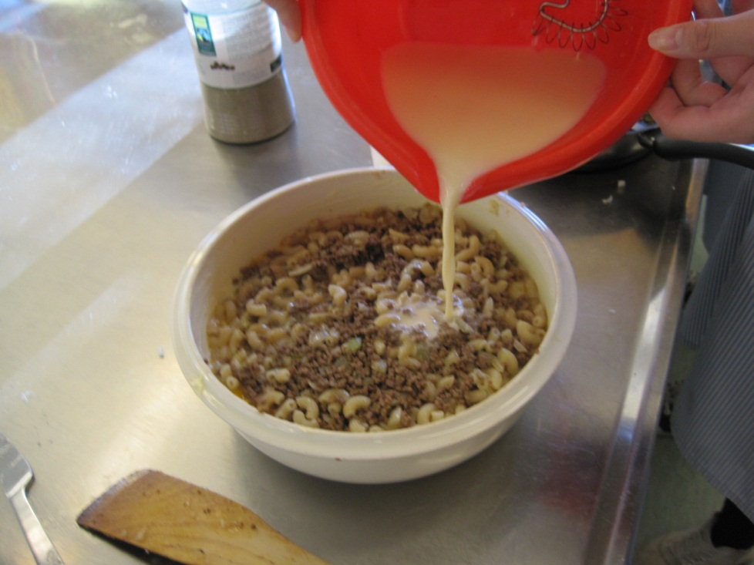
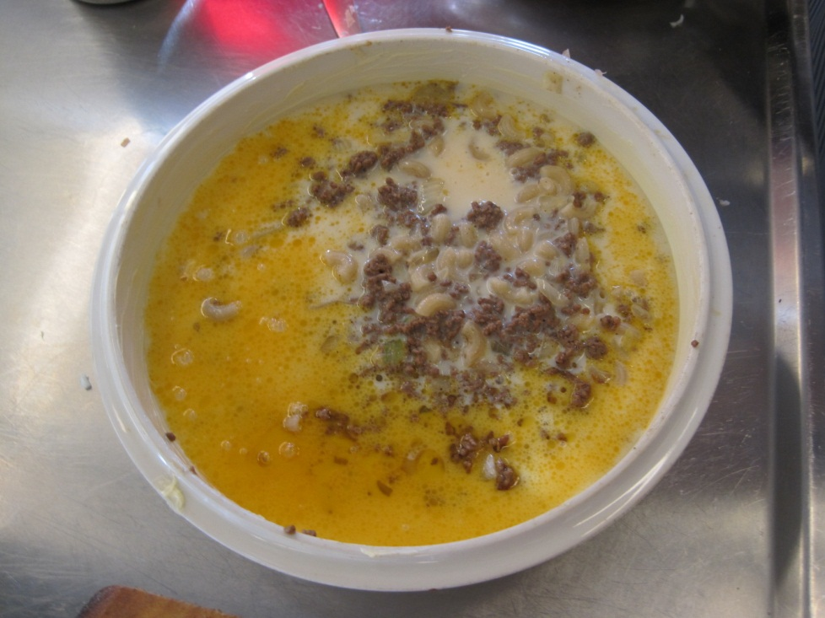
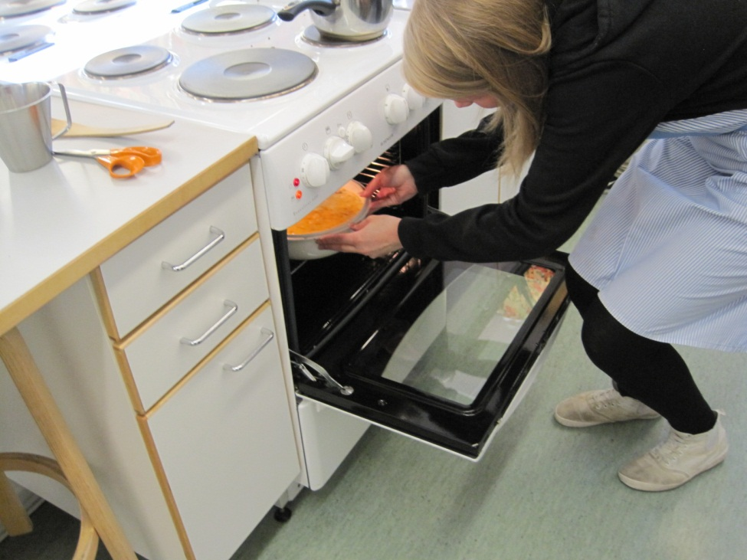

Slide 5
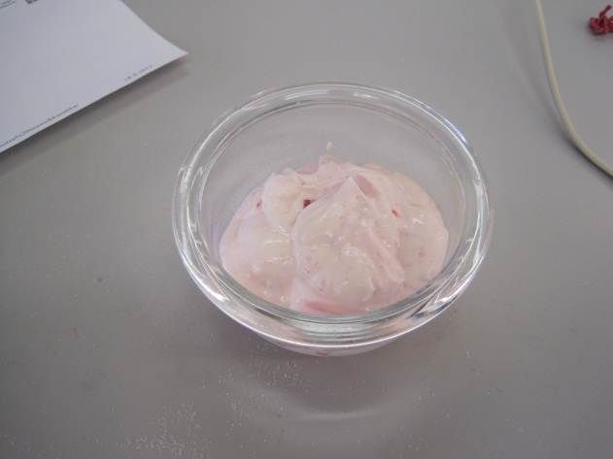
Strawberry quark (4 persons)
Ingredients:
1 tbsp vanilla sugar
½ dl sugar
¾ l strawberries
250 g quark
2 dl whipping cream

Slide 6
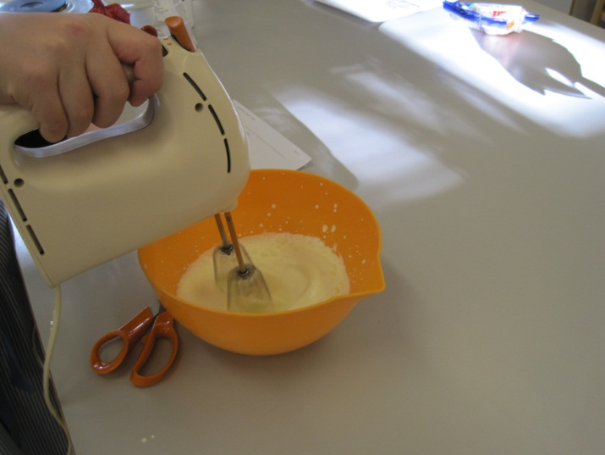
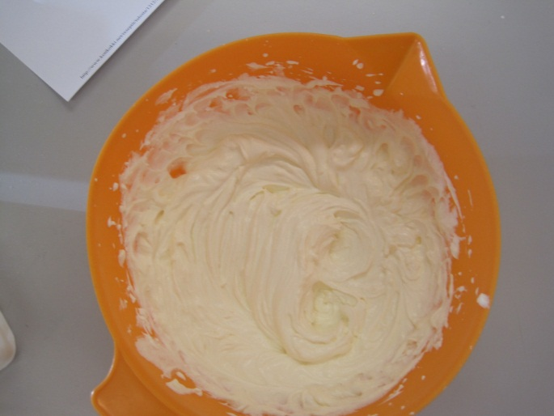
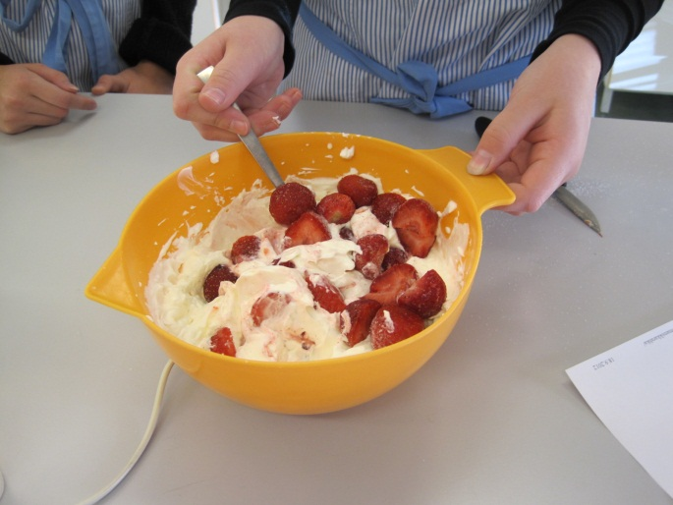
Instructions
Whip the cream.
Mix the whipped cream with quark.
Quarter the strawberries.
Add the vanilla sugar, sugar and strawberries.
Mix all the ingredients.

Slide 7
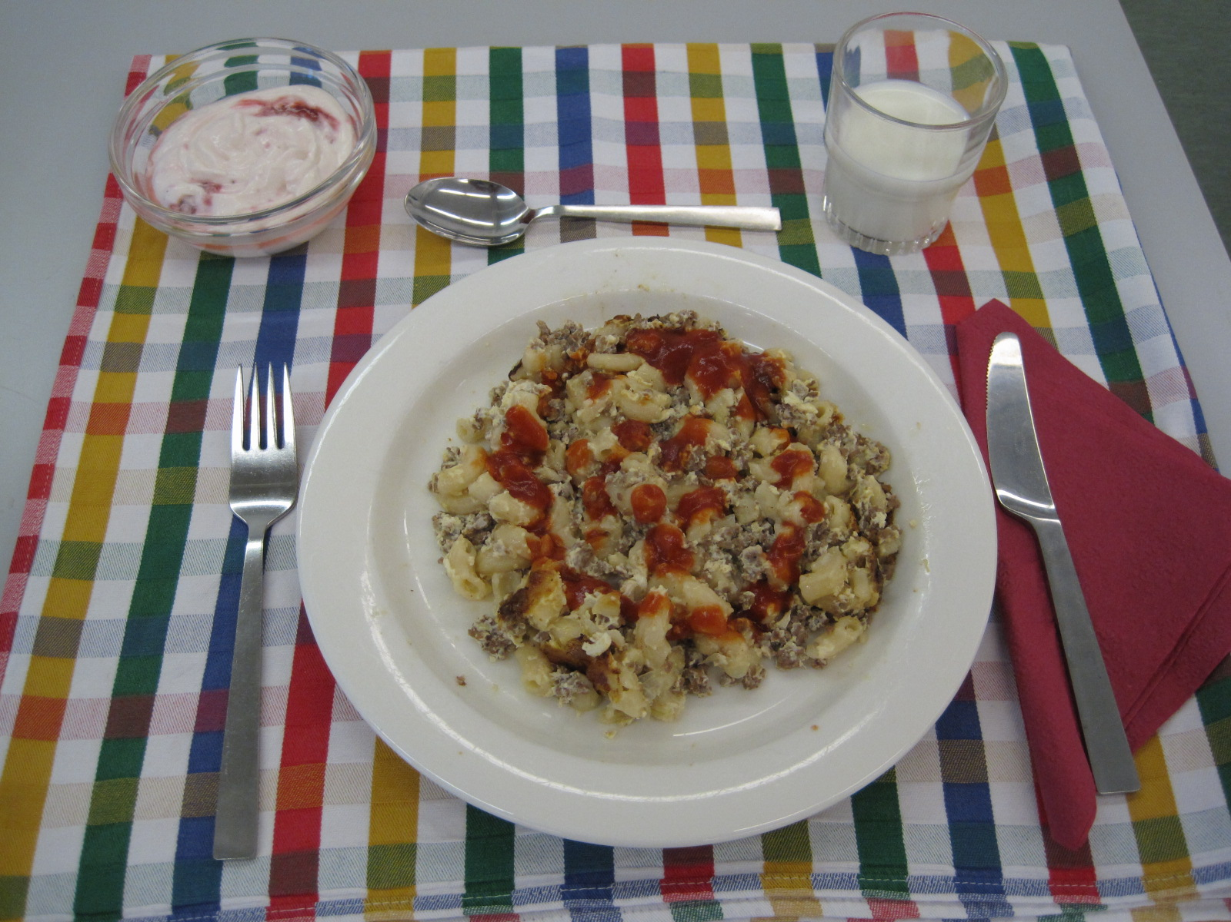

Slide 8
