Slide 1

POLISH DISHES
SHARING IS LEARNING
Gimnazjum in Zalesie Górne
October 2012

Slide 2
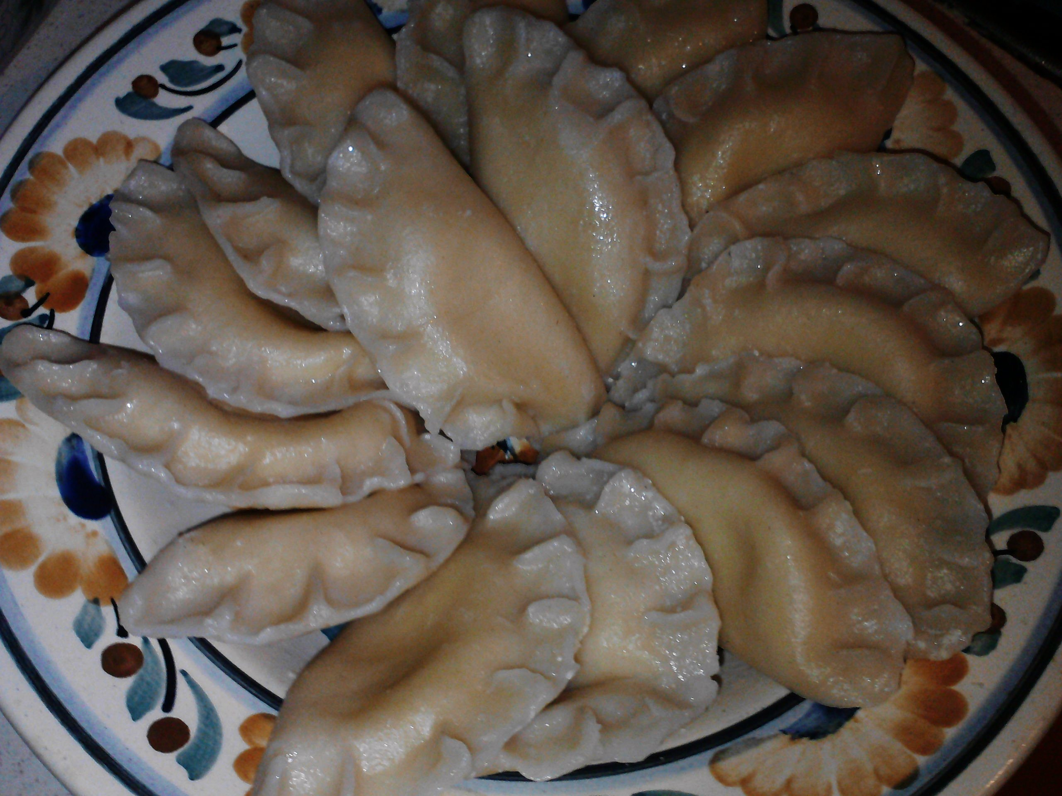
PIEROGI
Pierogi or dumplings are popular in central and eastern Europe. Traditionally considered peasant food, they have gained popularity and spread throughout all social classes.

Slide 3
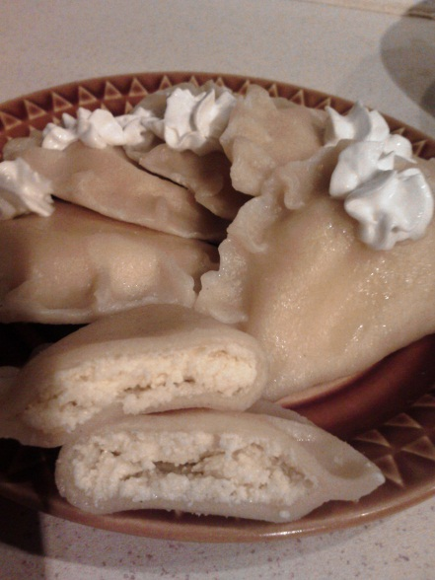
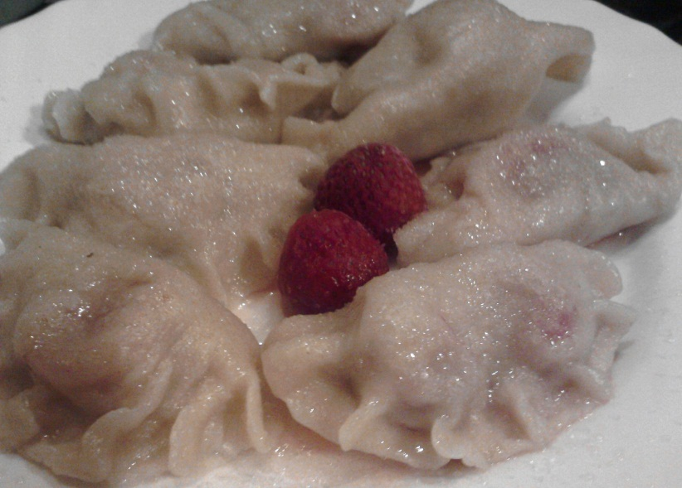
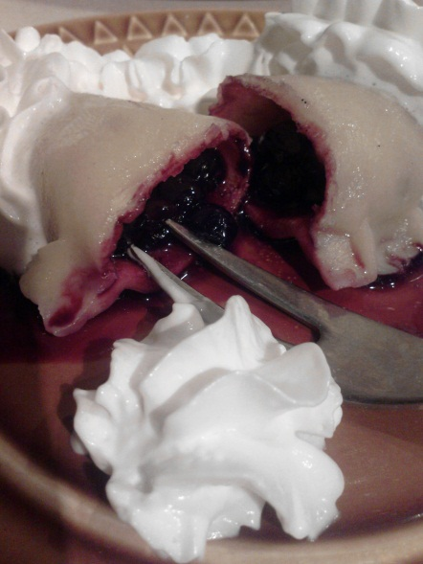
They may be stuffed with:
mashed potatoes,
cabbage,
ground meat,
white cheese,
mushrooms,
spinach,
cherries,
blueberries
strawberries
or other ingredients.

Slide 4
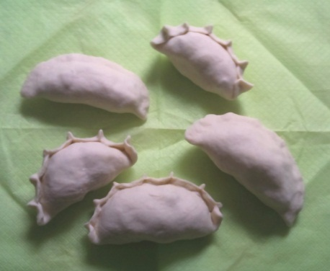
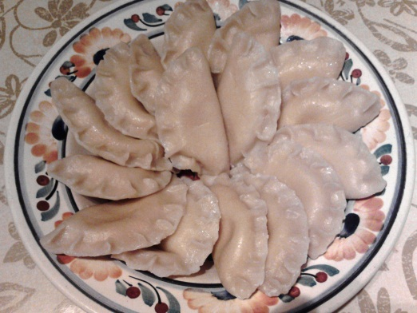
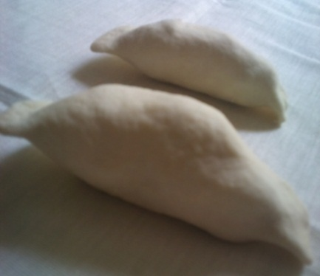
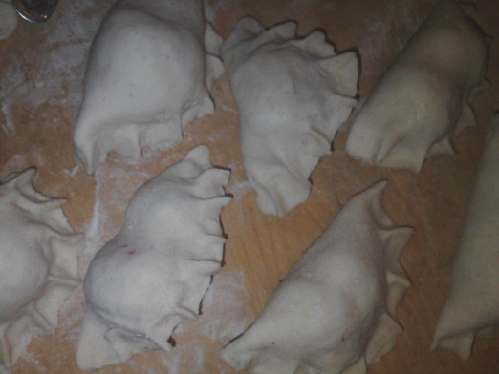
UTENSILS:
meat grinder
frying pan
kneading board
rolling pin
1 large bowl
1 large cooking pot
skimmer
1 cup / glass
tablespoons, teaspoons, forks
serving dish
cooker

Slide 5
PIEROGI WITH MEAT FILLING
Serves: 4 Difficulty: easy Cost: cheap Time: 1,5 hours
INGREDIENTS
For the dough:
500g flour
250ml water or milk
1 tablespoon butter
1 teaspoon salt
For the meat filling:
500g pork or beef (cooked and ground)
2 onions
30g butter
pepper, salt, marjoram

Slide 6
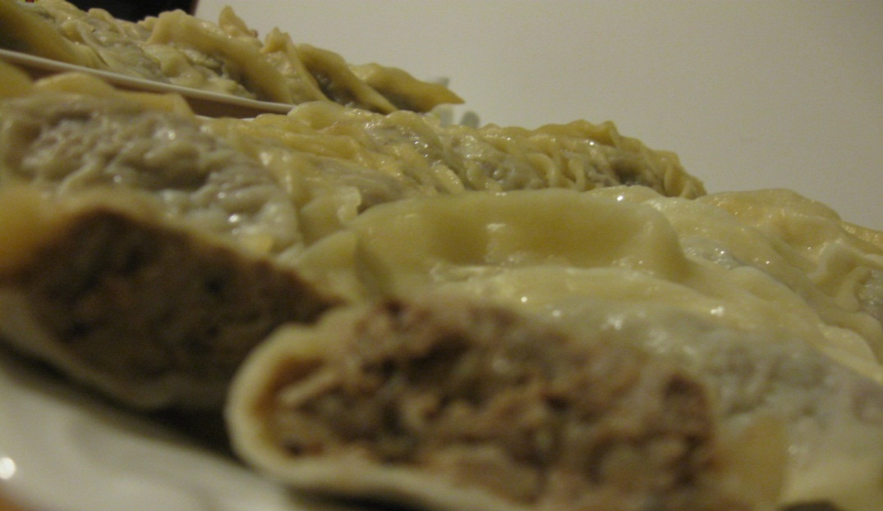
DIRECTIONS
The meat filling:
Cook the meat until it is soft. Then grind it with a meat grinder.
Peel the onions, chop finely and fry in butter until they turn golden.
Put the ground meat in the bowl, add the fried onions, season with salt, pepper and marjoram.

Slide 7
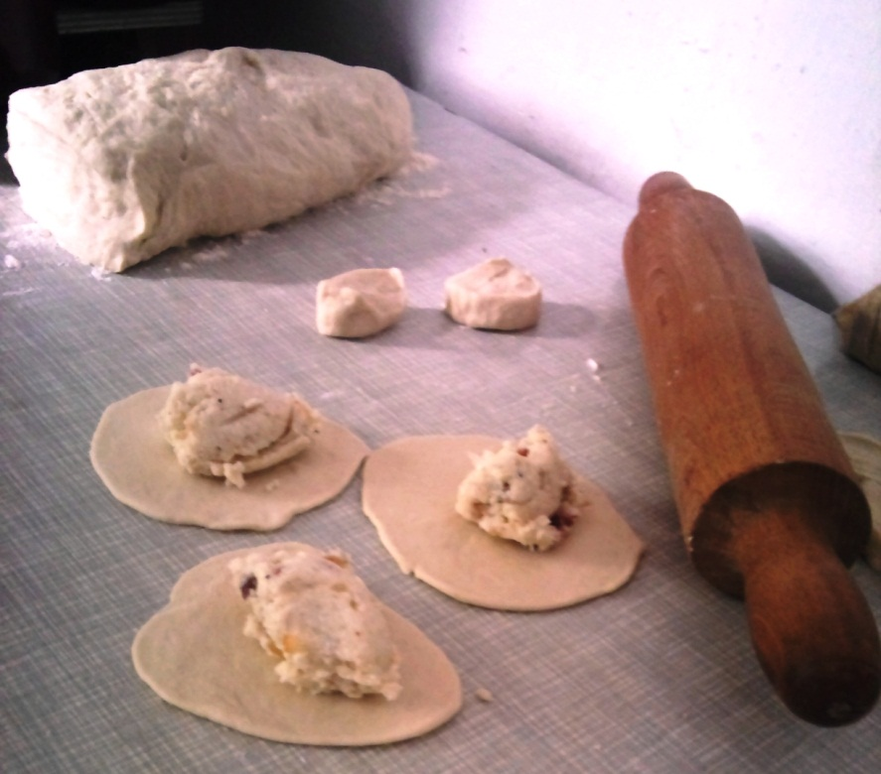
DIRECTIONS
The dough:
Sift the flour on the kneading board. Make a hole in the middle and pour in a tablespoon of melted butter. Add 1 teaspoon of salt. Gradually pour hot water (or milk). Mix with a knife first and then knead with your hands until you get smooth dough.
Divide the dough into 2 or 3 portions and one by one roll them flat so that they are about 2mm thick.
Cut circles using a cup or a glass.
Place the meat filling in the middle and fold the dough to form a semi-circle. Make sure you press the edges together to seal the dumplings.

Slide 8
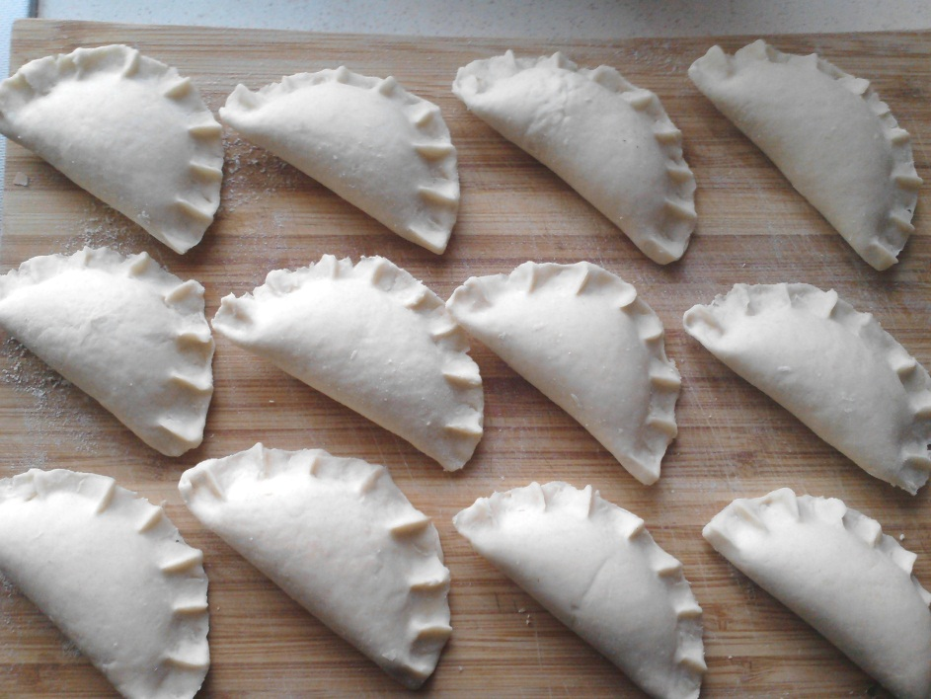
DIRECTIONS
Cooking
Boil salted water in a large pot. Throw the dumplings into the boiling water, wait until they start to float and let them boil for another 2-3 minutes.
Get them out of water with a skimmer and place on a dish. Eat when still warm.
Pierogi can be served with melted butter or small pieces of fried bacon. They are delicious with borscht (beetroot soup).

Slide 9
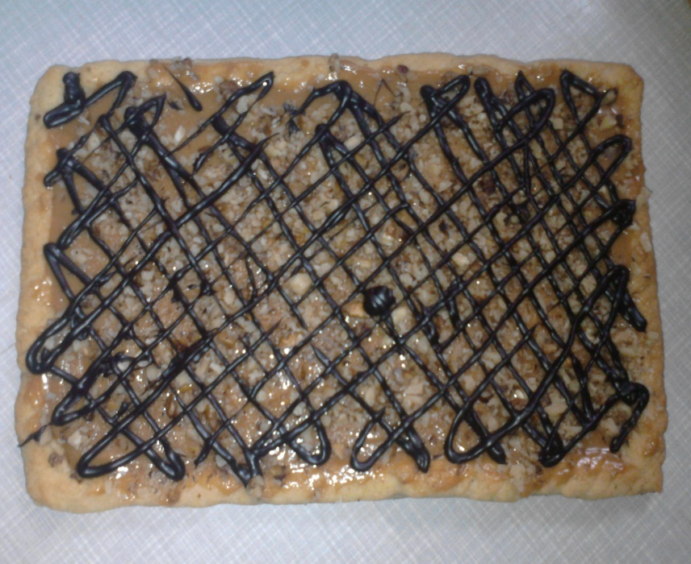
And sweet…

Slide 10
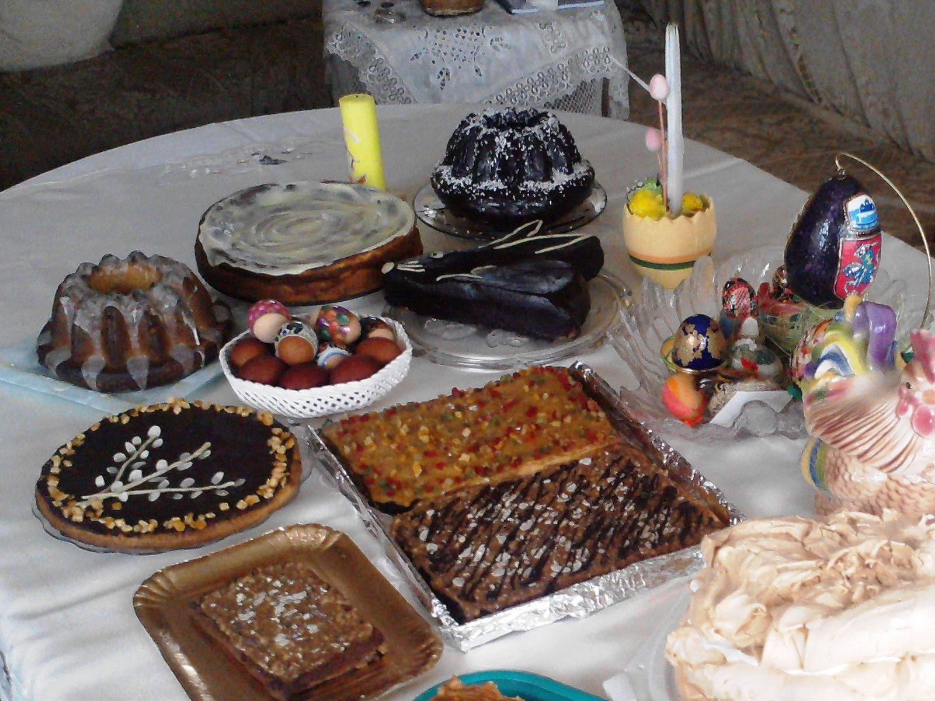
MAZUREK
Mazurek is a type of cake baked in Poland, particularly at Easter. It comes in various shapes and flavours. It is decorated with icing and dried fruit, almonds and nuts.

Slide 11
MAZUREK WITH CHOCOLATE ICING
Serves: depending on your appetite; you get 2 baking dishes of cake
Difficulty: easy Cost: rather cheap Time: 1,5 hours
INGREDIENTS
For the pastry base:
500g flour
250g margarine or butter
200g sugar
4 egg yolks
2 tablespoons sour cream
1 teaspoon baking powder
For the icing:
250g margarine
400g sugar
6 tablespoons cocoa powder
6 tablespoons water
For the decoration:
almonds, nuts, dried fruit: dates, apricots, raisins

Slide 12
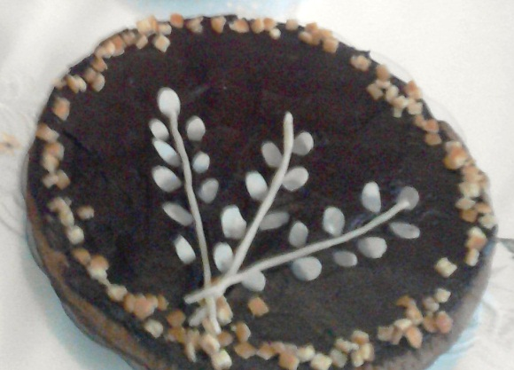
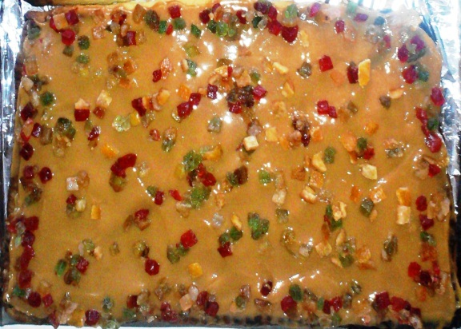
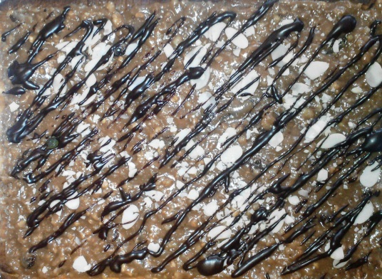
UTENSILS:
kneading board
rolling pin
2 baking dishes (cake tins)
small pot
small bowls
oven
cooker
teaspoons, tablespoons, knives, fork
serving dish

Slide 13
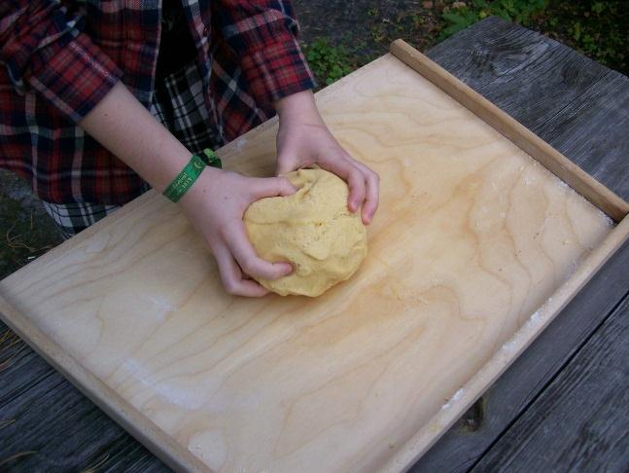
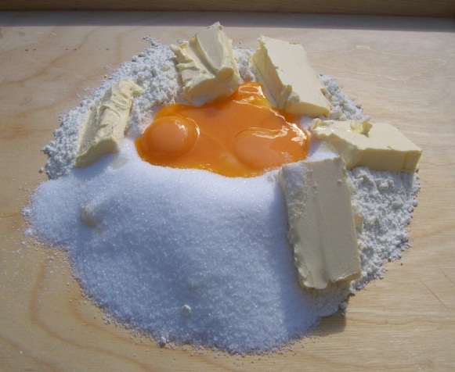
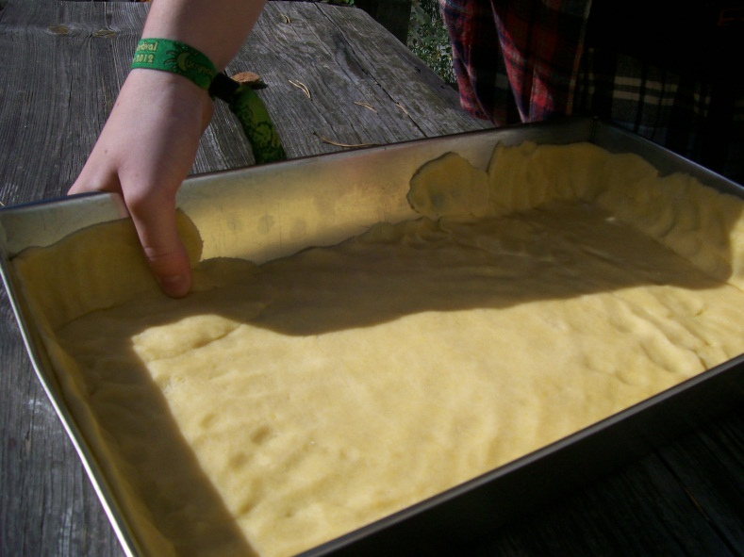
DIRECTIONS:
Knead until you get smooth dough.
Sift the flour on the kneading board, add sugar, margarine, egg yolks, cream and baking powder.
Preheat the oven to 180 – 200°C.
Roll the dough so it is about 5 mm thick and pat it evenly into a greased baking dish. Make thin walls of the dough around the baking dish. Prick with a fork.
Bake for about 25 – 30 minutes until golden brown.
Remove from the oven and leave to cool for 20 minutes.

Slide 14
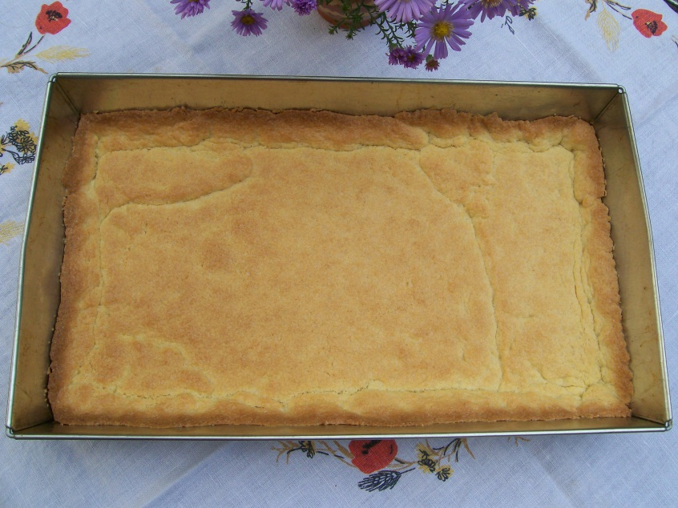
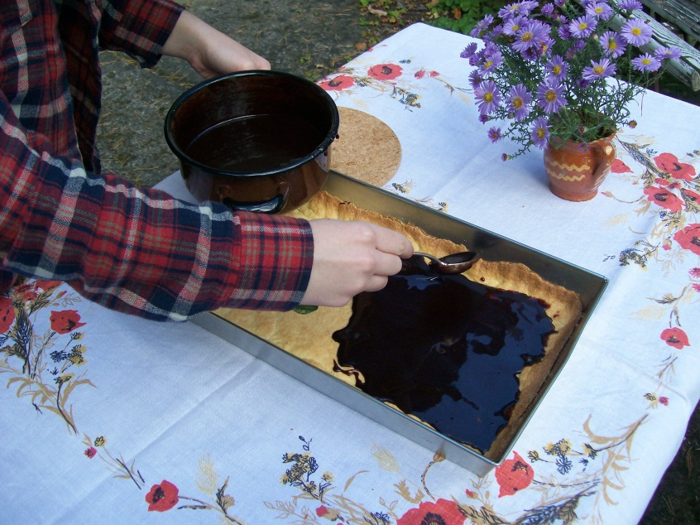
DIRECTIONS:
To prepare the icing, mix the margarine, sugar, cocoa and water in a small pot.
Heat on the cooker until the ingredients melt. Cook for 1 minute stirring continuously.
Then leave to cool a bit.
Pour the chocolate icing on the pastry base and spread evenly.

Slide 15
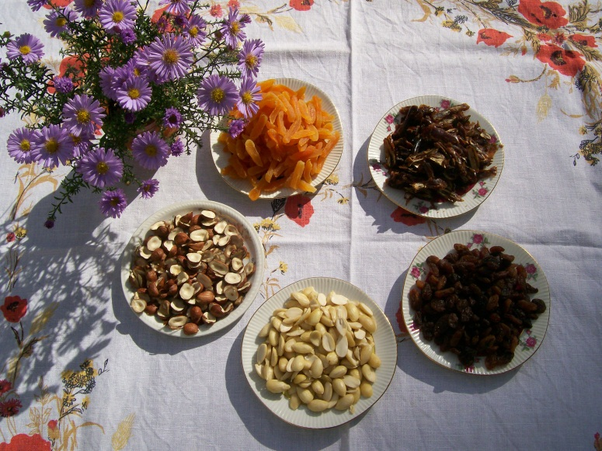
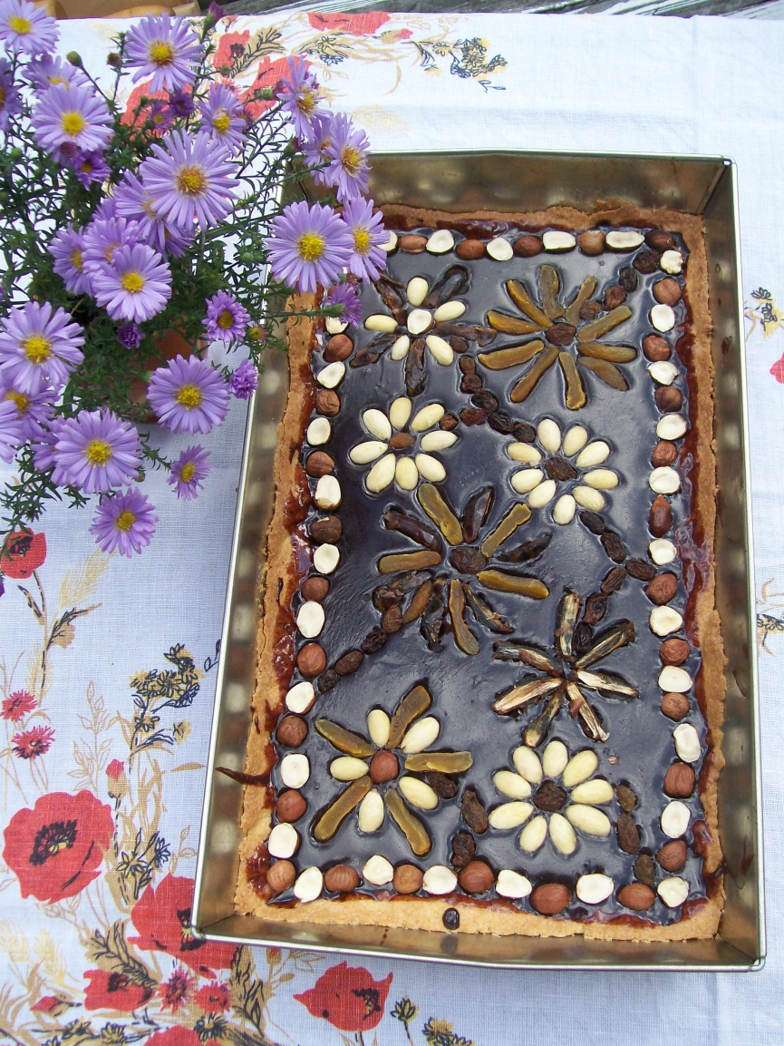
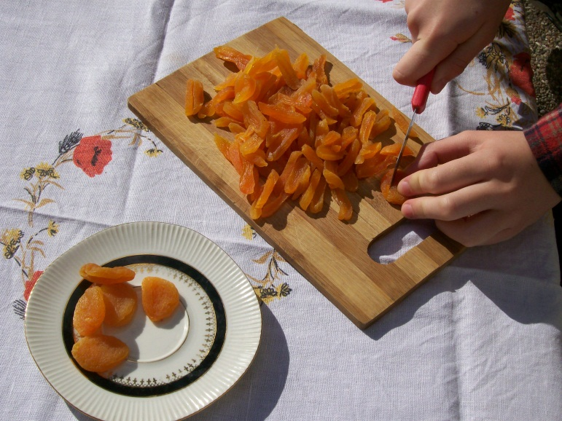
DIRECTIONS:
Let it set and decorate with almonds, nuts and dried fruit.

Slide 16
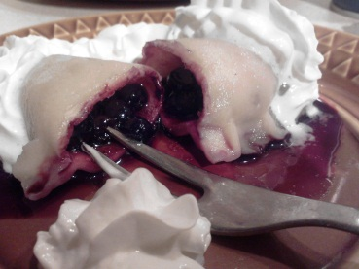
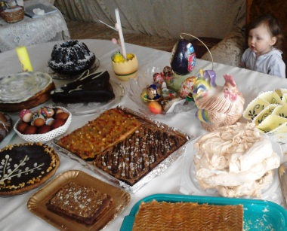
Recipes:
THANK YOU FOR YOUR ATTENTION!
Photos:
Marta Pastuch
Zosia Pazdrowska
Dorota Szejner
Marta Pastuch
Piotr Pluta
Zosia Pazdrowska
Monika Sochacka-Kukiełka

