Slide 1
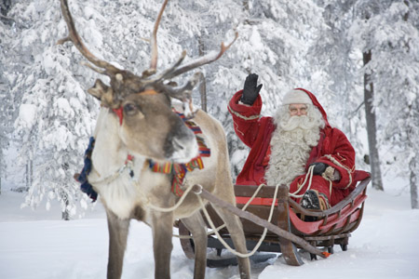
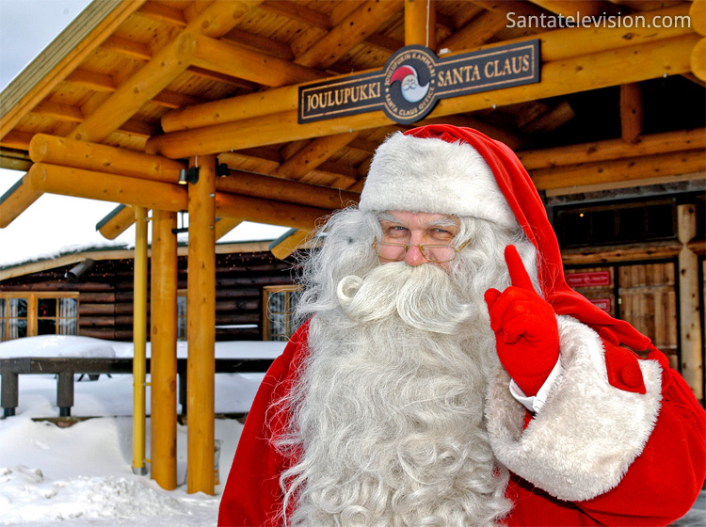
Santa Claus in finnish ’’Joulupukki’’, is a finnish figure. Santa lives in Korvatunturi better known as North Pole.

Slide 2
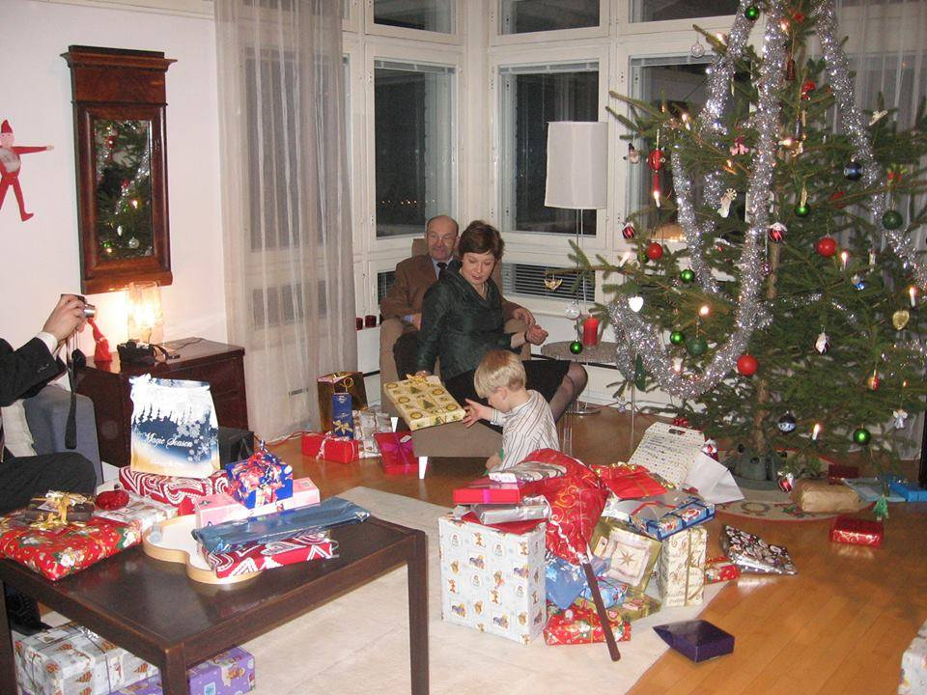
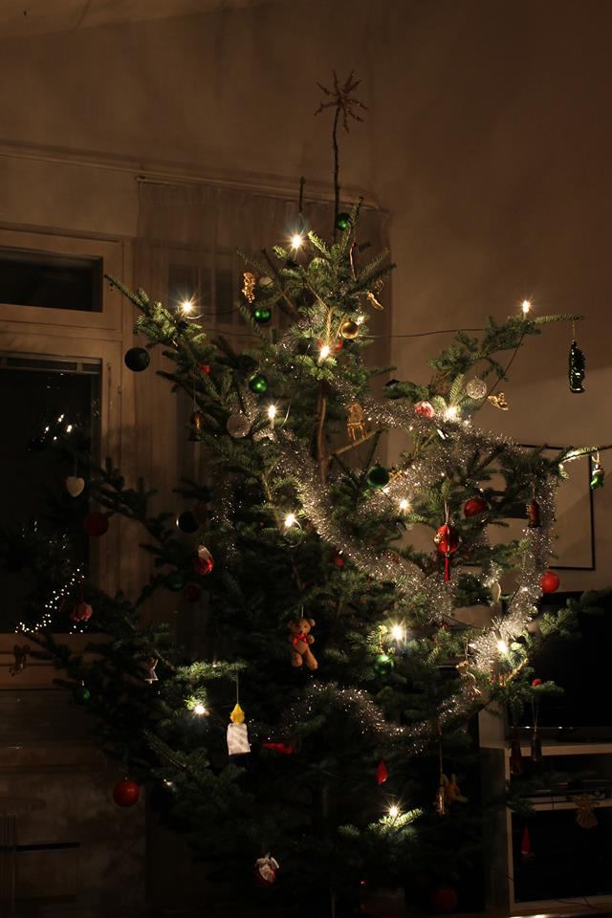
Finnish Christmas tree is a real spruce. Families decorate Christmas tree together before Christmas Eve. Santa comes and give the present to children, usually they sing Santa a Christmas song.

Slide 3
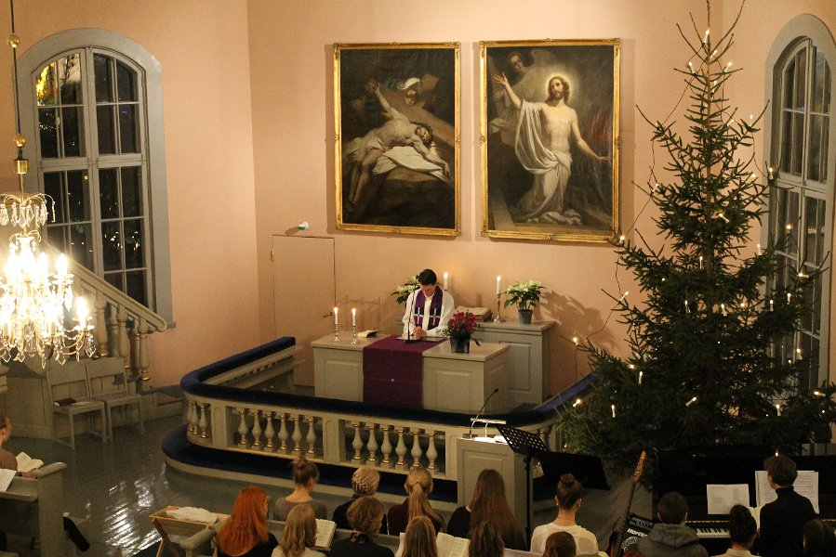
Christmas church is in Christmas Eve. People come to hear Christmas gospel, which describes the birth of Jesus, the angels´ announcement to the shepherds of Christ's birth. Church ceremony is held at night between Christmas Eve and Christmas Day.

Slide 4
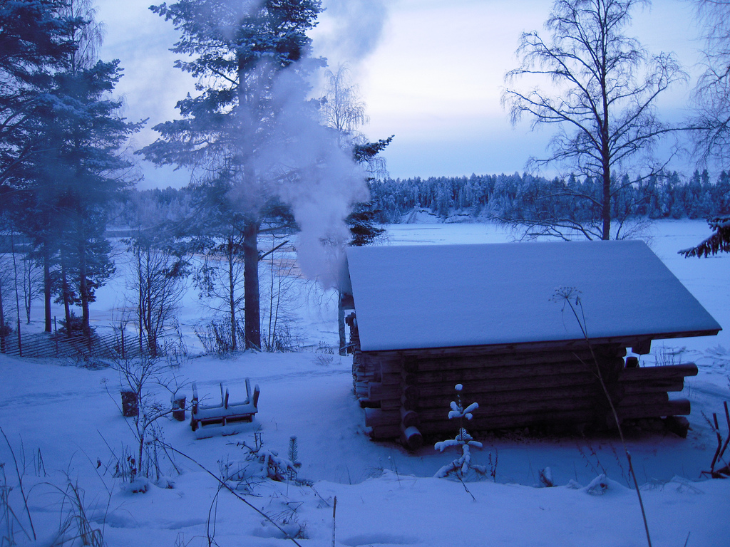
Christmas sauna is a finnish tradition on Christmas Eve. It is an old finnish Christmas tradition, which is prepared for the devotion and care.

Slide 5
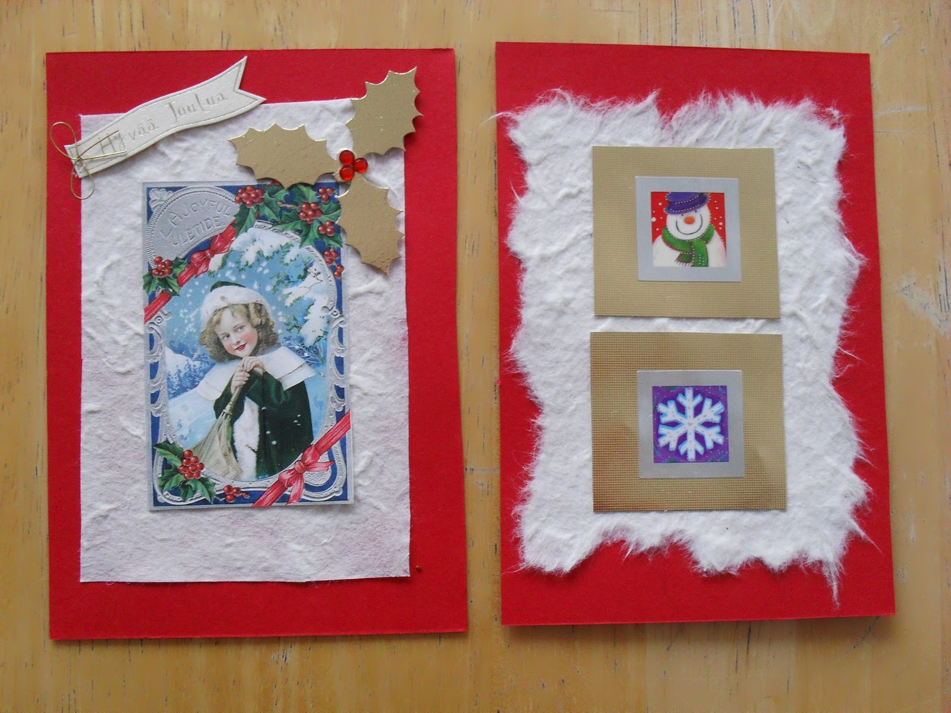
Christmas cards are sent at Christmas. Many children send Christmas cards to Santa Claus. In 2010 Santa Claus received about 600 000 letters from around the world

Slide 6
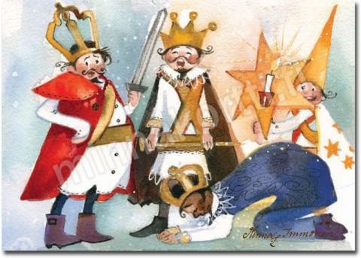
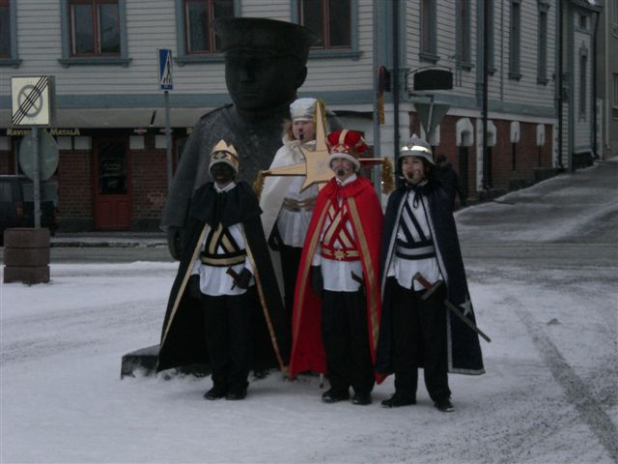
Carol Singers called Star Boys is a centuries old finnish Christmas tradition. It´s a song play by the young boys who went round the houses to perform the play. The tradition is known especially in Northern Finland. In Oulu Carol Singers tradition has remained strong.

