Slide 1
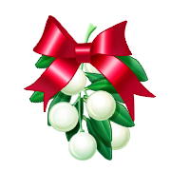
Traditional Finnish Christmas Food
Made by: Ilona, Oona, Netta, Anna

Slide 2
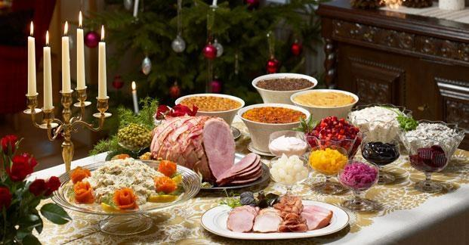
Christmas Dinner
Traditional Finnish Christmas Dinner consists of ham, cassaroles, beetroot salad, different kind of fish and for dessert mulled wine, gingerbreads and plum curd.

Slide 3
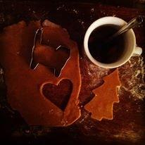
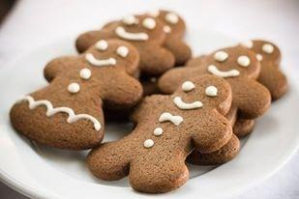
Gingerbread
Finns call these cookies to ”piparkakut” and decorate them as Christmas trees or other Christmassy things like stars.

Slide 4
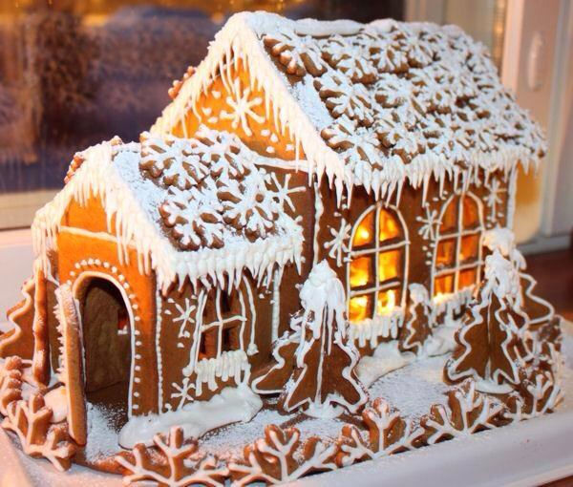
Gingerbread houses

Slide 5
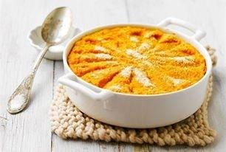
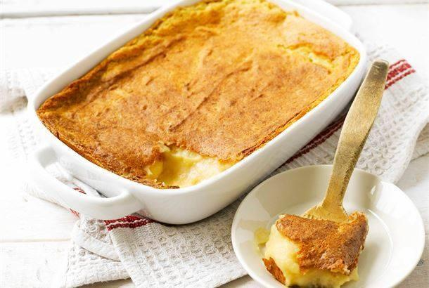
Casseroles
Carrot casserole
Potato casserole
Casseroles are made of different kind of root vegetables. They are spiced with for example nutmeg and ginger.

Slide 6
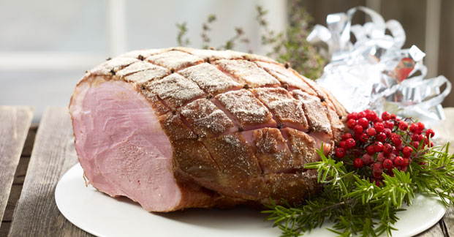
Christmas ham
Christmas ham is made of pork meat. You let it brew in the oven all day. You usually eat it with boiled potatos. In Finland we also eat turkey.

Slide 7
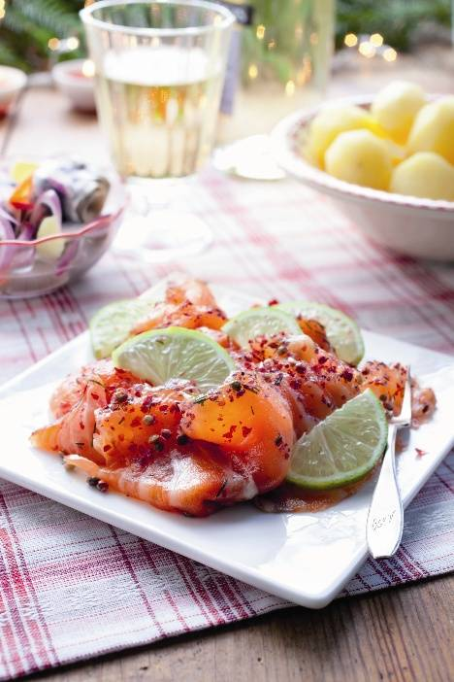
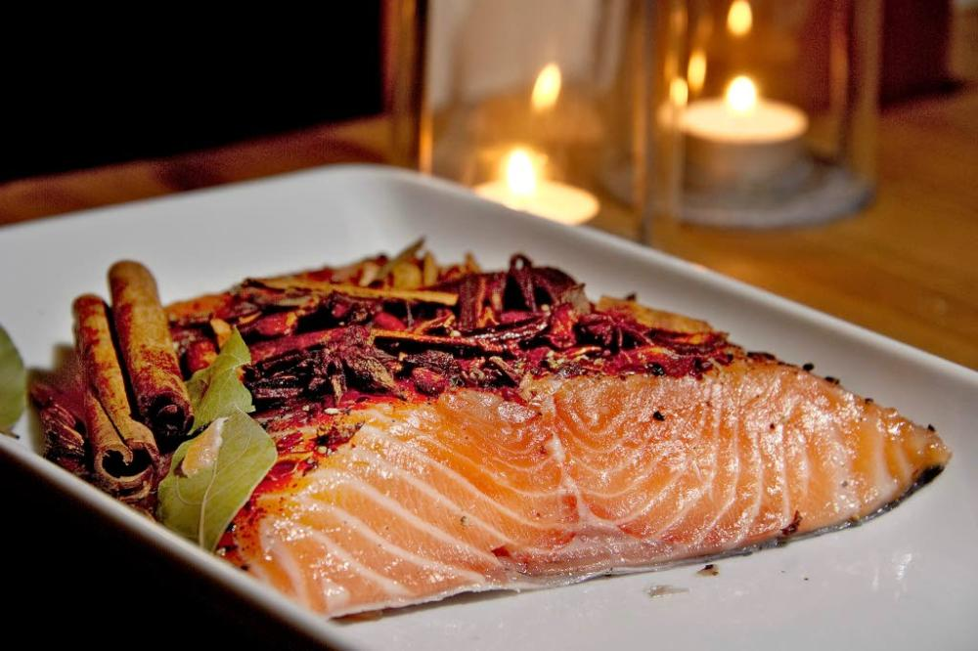
Christmas fishes
Traditional christmas fishes in Finland are salmon, whitefish and herring. Fishes are salted and usually raw.

Slide 8
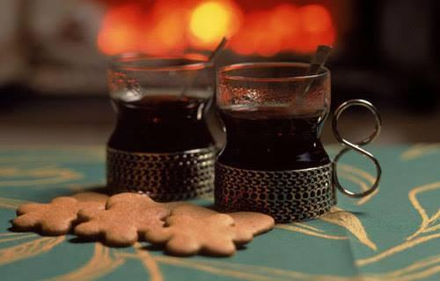
Mulled Wine ”Glögi”
Glögi is made of wine, liquor or water. Alcohol-free glögi is made of grape juice. To make it more Christmassy you add there spices like cinnamon, clove and ginger. You usually drink glögi with almonds and raisins.

Slide 9
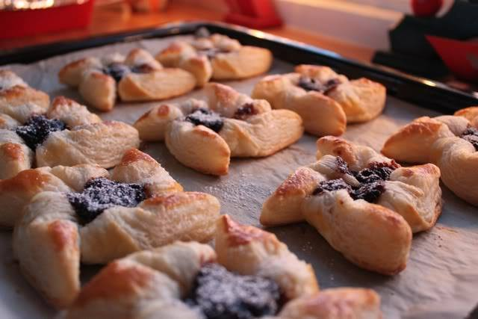
Mince pie
Mince pie is a pastry made with pastry dough with butter. The pie is usually filled with plum jam. Finnish mince pies are often star-shaped, but you can bake other shapes too.

Slide 10
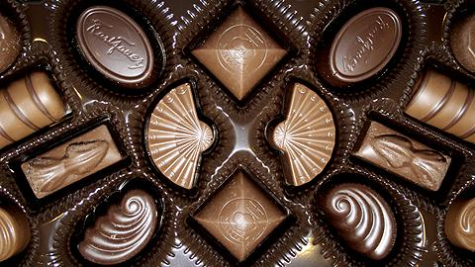
Chocolate fondant
Chocolates are big favorite with finns at Christmas. They are filled with different kinds of fillings, for example cranberry, caramel, coffee cream and truffle. Karl Fazer is famous finnish chocolate brand.

