Slide 1
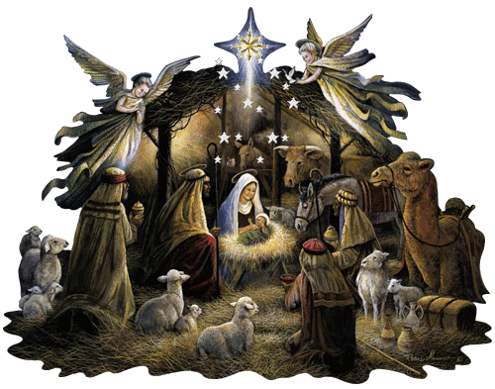
The nativity scene
By Lubna, Leïlani and Karla-lina

Slide 2
The nativity scene
The nativity scene is a representation of the birth of Jesus in miniature.
It’s represented by figurines of terracotta.
We say that Jesus was born in a stable.
We put a baby on the center of the stable at t midnight to symbolize his birth, he is surrounded by Mary and Joseph. They are accompanied by a donkey and a cow.
It’s notable that the virgin Mary is very often represented knelt in front of her son.
It’s frequent to put a star on the top of the nativity scene. This star is the star which guided, according to the scriptures, the wise men: Gaspard, Melchior and Balthazar.They symbolize the three continents(Europe, Africa and Asia).

