Slide 1
Christmas in France
By Elie,Valentin,laurent and Robin.

Slide 2
How is Christmas in France?
Christmas is a religious celebration celebrating the birth of Jesus every year.
We exchange presents and wishes with others. It’s also bank holiday the 25th of December. In France, the habit to use celebrate Christmas varies a lot from one region to another.
The meal
During the celebration in France, we use to eat turkey , chestnuts , “foie gras”.
this meal ends with a “bûche de Noël”. There is also a tradition that comes from Province that consists in serving thirteen desserts in memory of Jesus with his twelve apostles.
Children receive their presents on Christmas night.
The Christmas tree and decorations
The Christmas tree is associated with Christmas presents. It’s also the time to prepare the stocking and the socks to put next to the chimney or under the Christmas tree to allow the “Père Noël” to deliver presents.

Slide 3
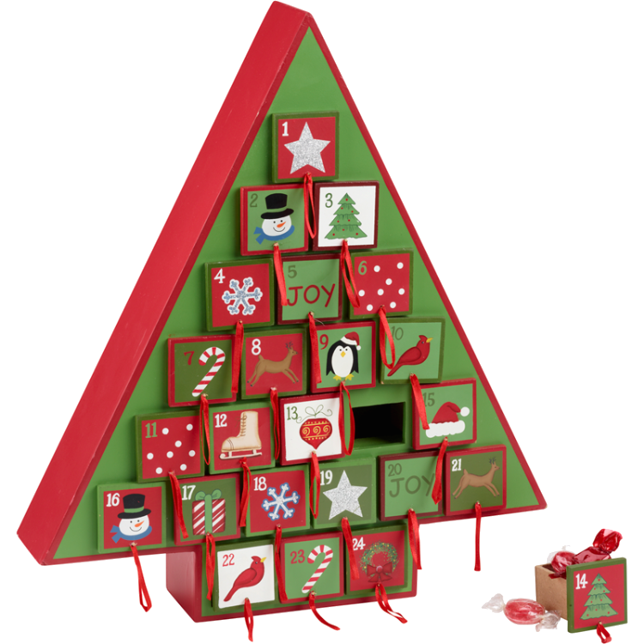
The Advent calendar
In order to make the children wait till Christmas parents offer a special calendar with twenty four windows. Every day the children open the window and find a surprise: chocolate, toy, candy…
There are different calendars, some are hand made, you can buy others in supermarkets.

Slide 4
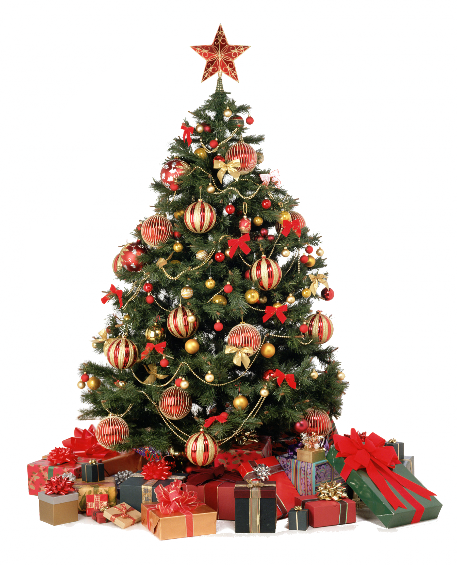
Christmas tree
The custom of the Christmas tree comes from The Renaissance in the German lands. There are many theories about its origins.
It’s the symbol of the new life’s light and is the traditional page's theme. At that time it was called the world tree. Other theories say that it comes from The Gaulle's Christians.
The tree is decorated, and on every tree, the tradition tells that the youngest has to put a star at the top of the tree. It began in the 18th century. This kind of calendar comes from Germany. At the XIXth century some protestant families distributed pictures every morning.

Slide 5
Christmas tree
In France, in every house, people use to have a Christmas tree. There are many kinds of Christmas trees. Some are made of plastic, others are real ones. Families begin the decoration at the very first days of December.
On top of the tree there’s a big star; usually the youngest child hangs it up. On December the 25th, everyone can find presents around the tree. For some families, presents are hidden in special long socks.
Now, the French, like the Americans do, to be more precise, decorating their outdoors too.

Slide 6
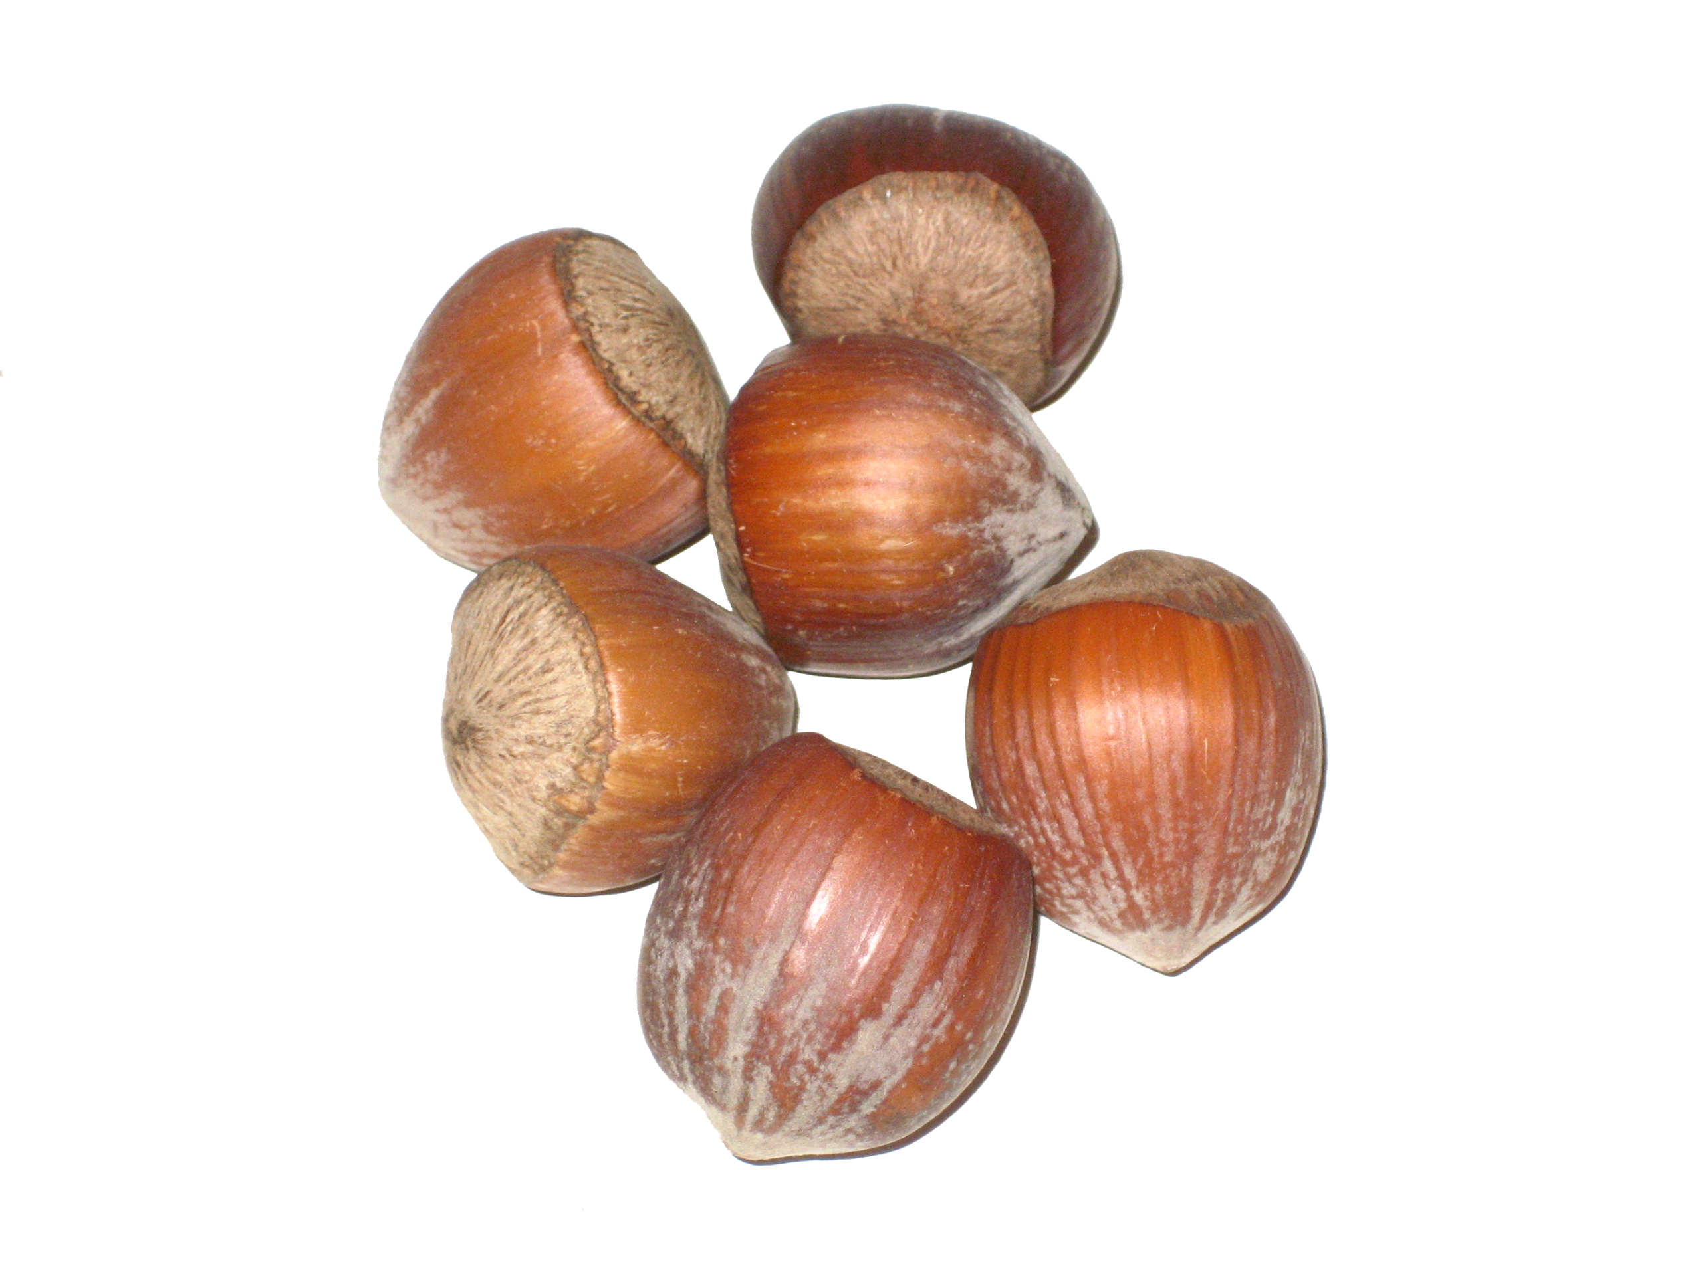
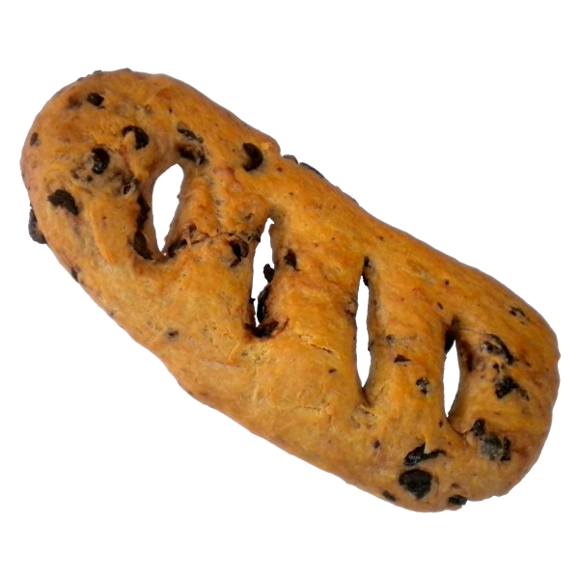
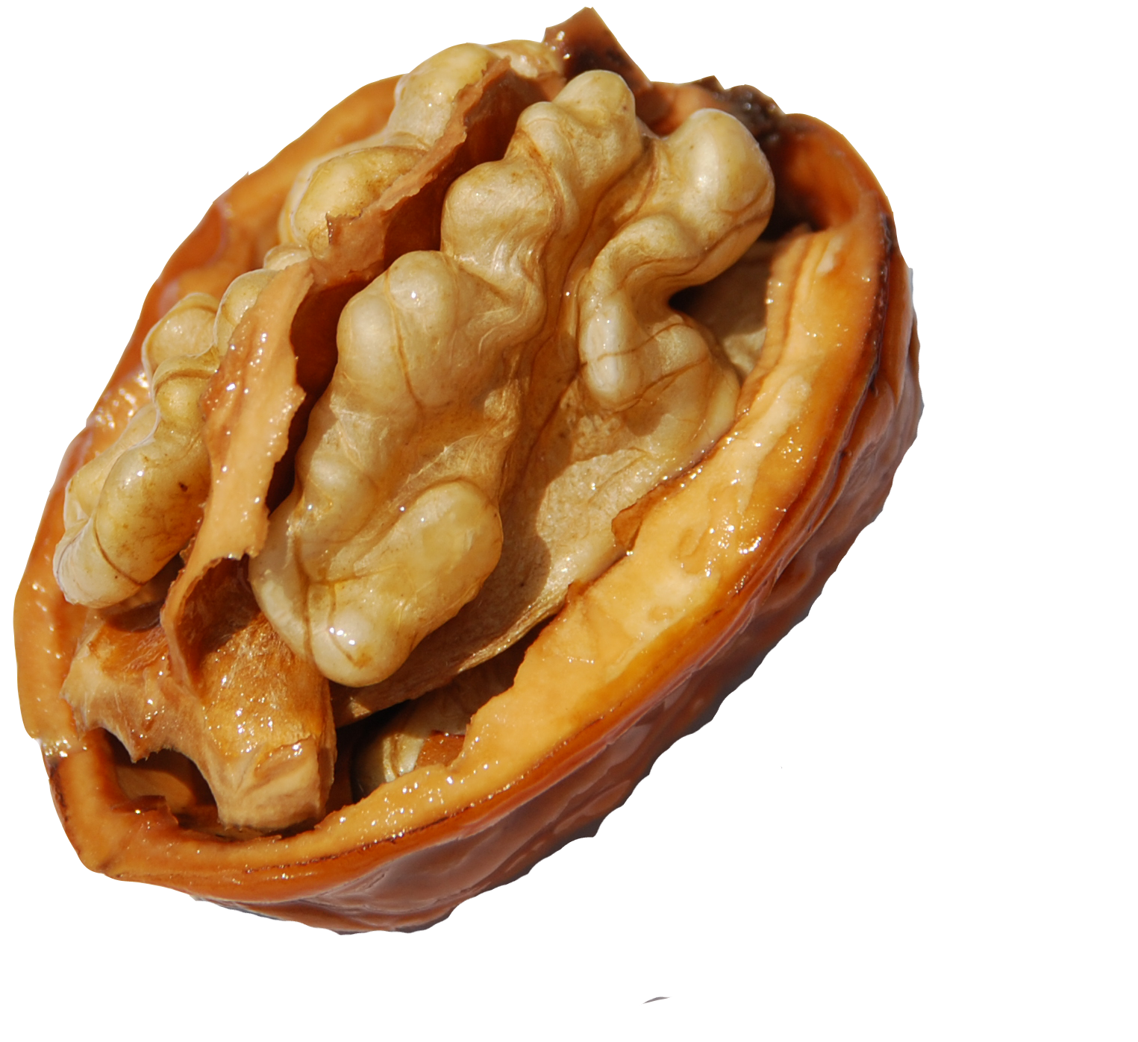
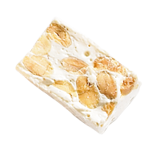
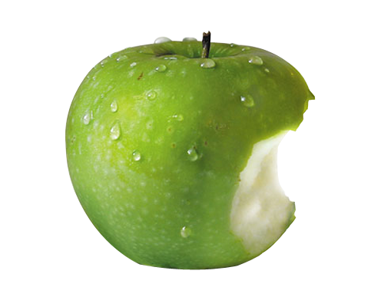
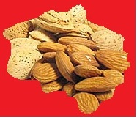
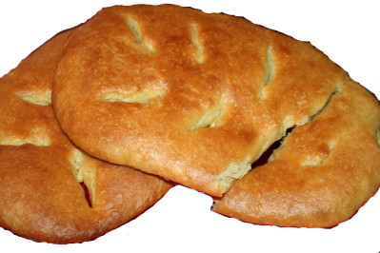
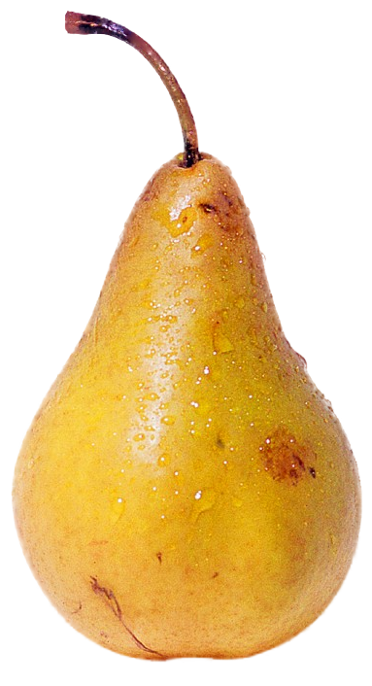
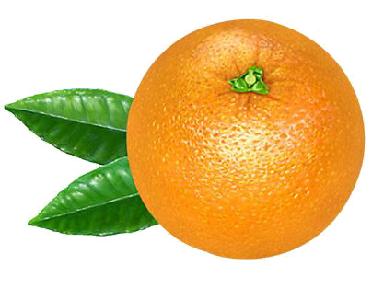
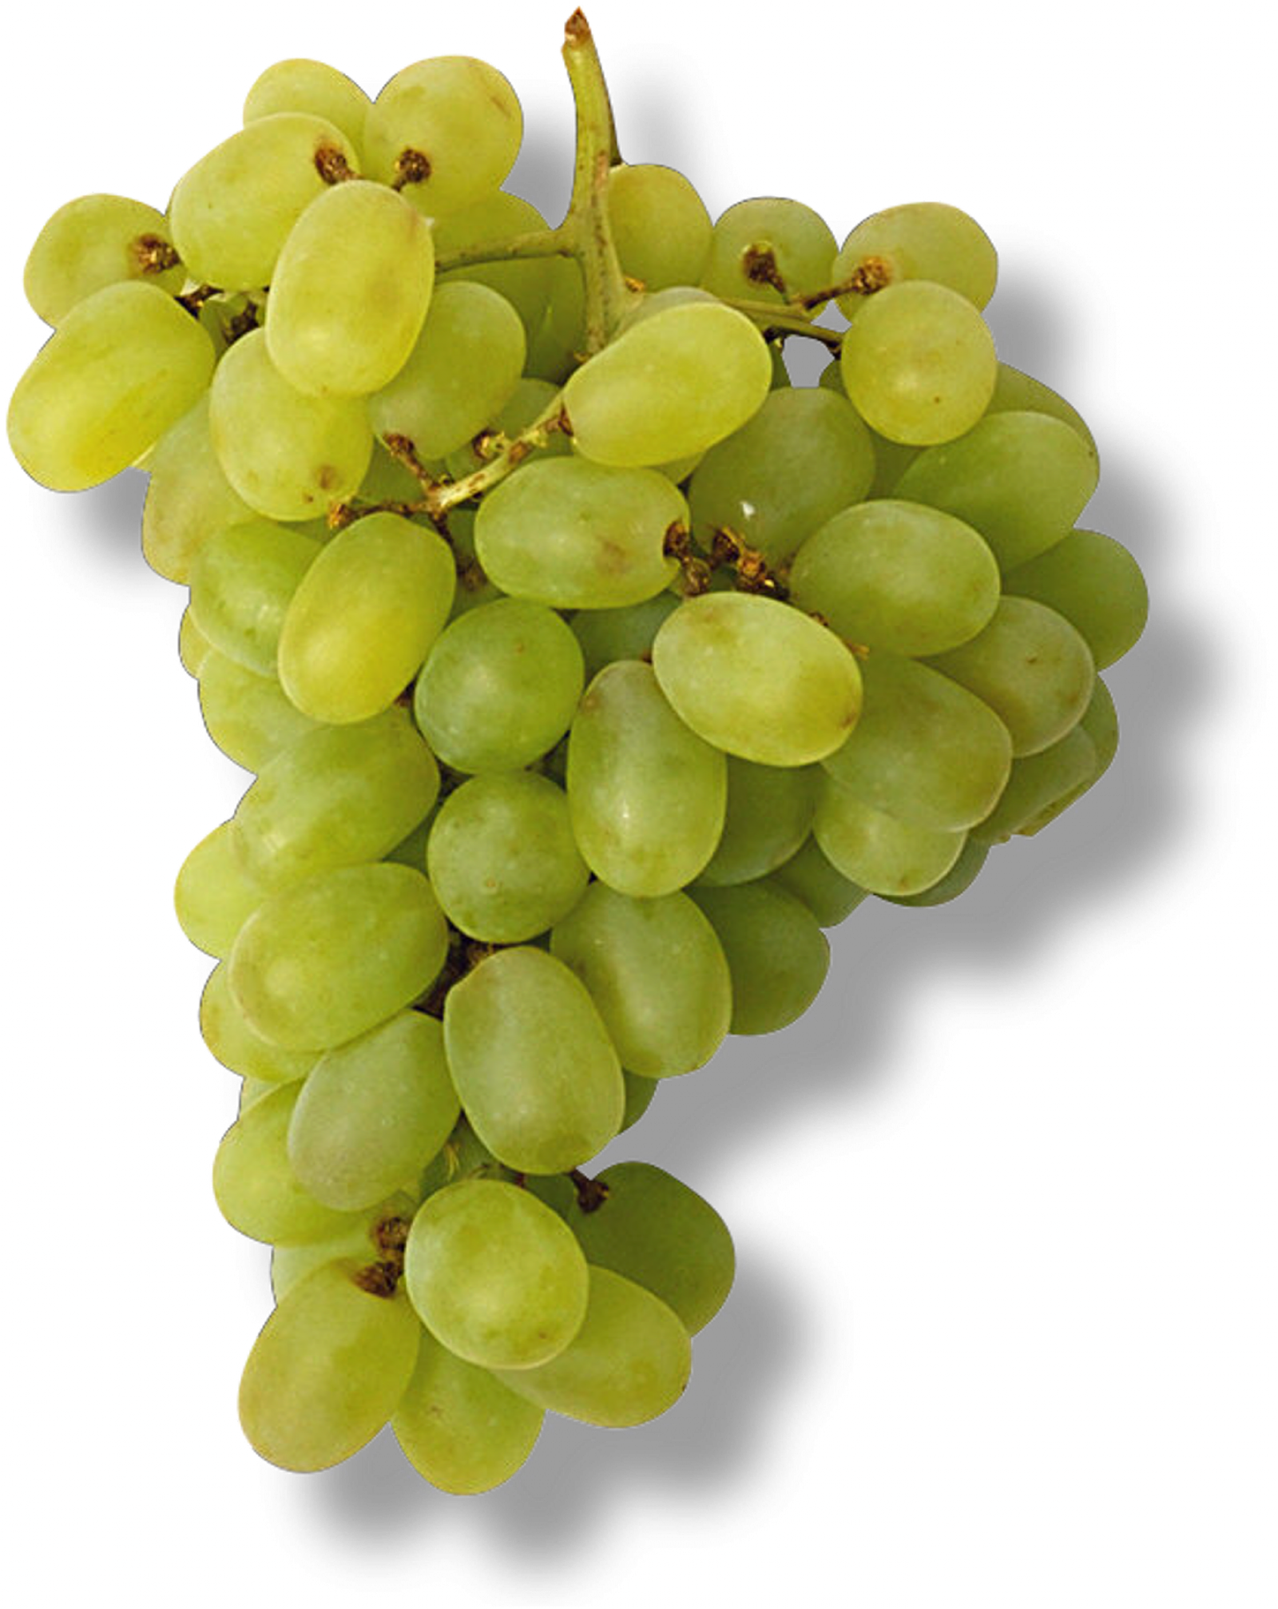
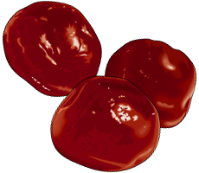
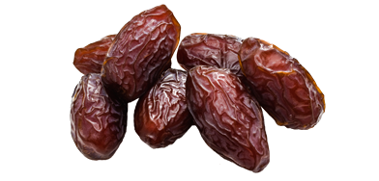
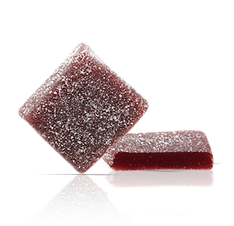
Thirteen desserts
In Provence, there is a special tradition called “the thirteen desserts”.
They symbolize “the Scene” with Jesus and the twelve apostles.
Pompe à l'huile | Fougasse | walnut | Nuts | Almonds | Nougat blanc | apples
Pears | Oranges | Raisins | Candied fruits | Dates | Pâtes de fruits

