Slide 1
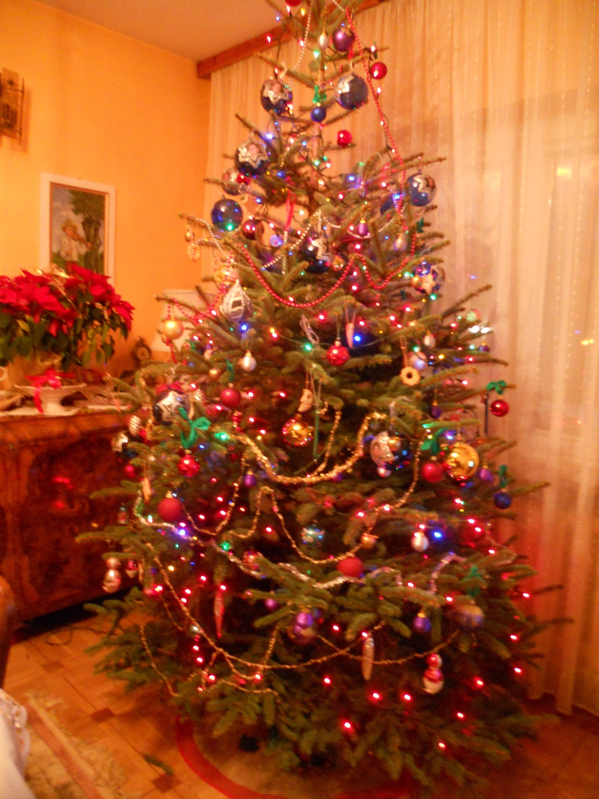
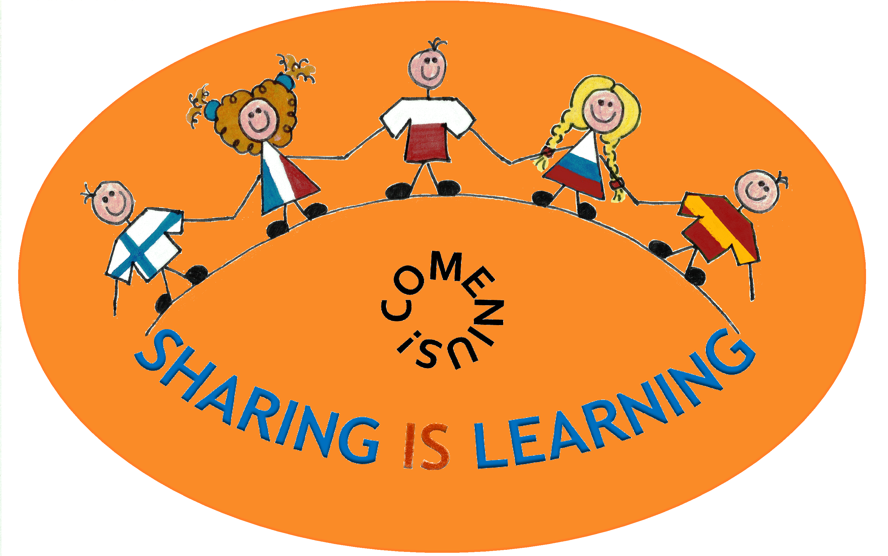
CHRISTMAS
IN POLAND

Slide 2
Before Christmas

Slide 3
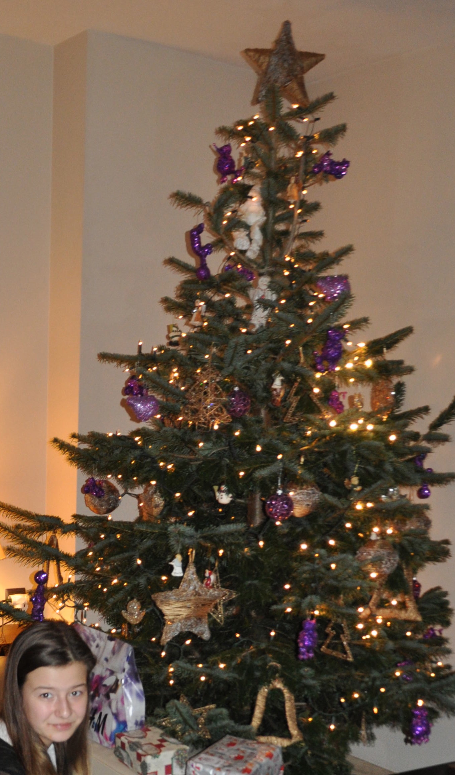
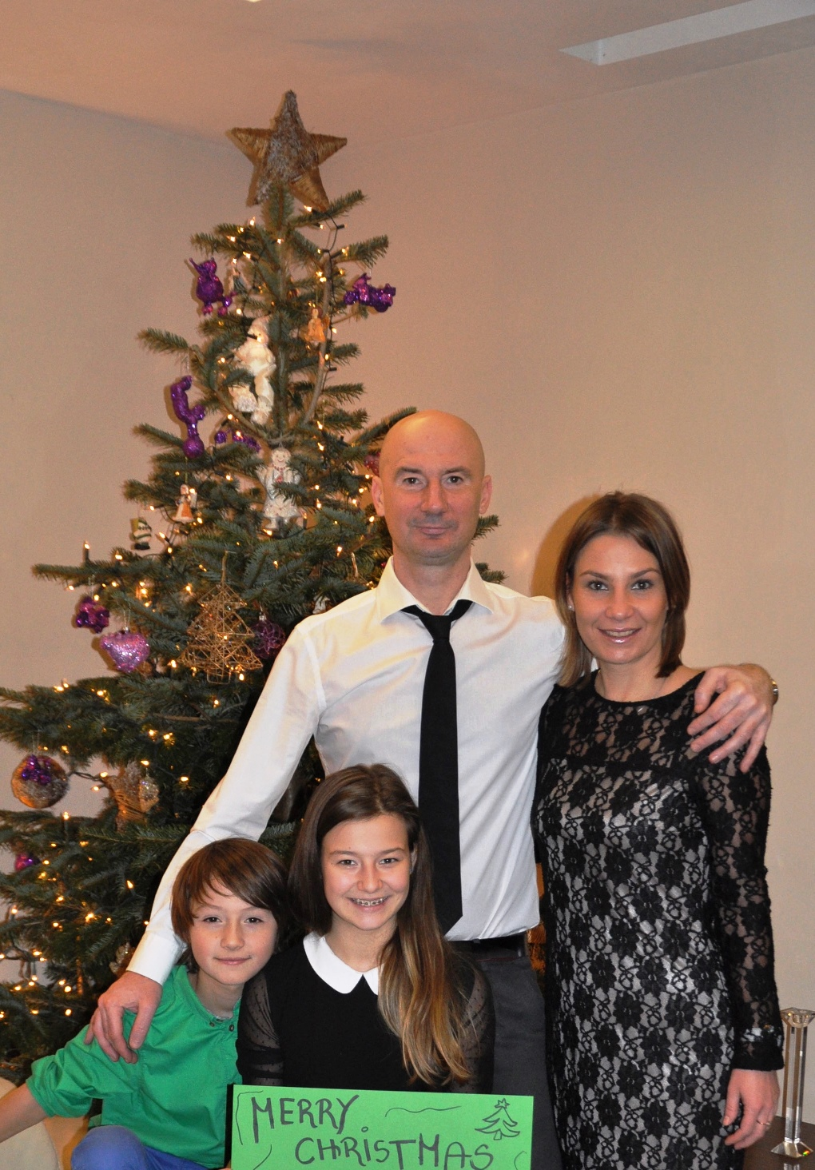
Christmas Tree
In Poland before Christmas people decorate the tree with handmade Christmas balls, lights and ornamentation. Christmas tree stays at home to Epiphany.

Slide 4
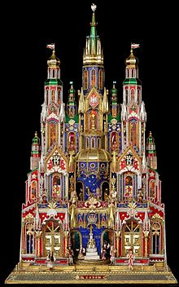
What is Crakow crib?
Kraków crib is a many-storied, richly ornamented construction. The tradition of making cribs dates back to 19th century.
Carpenters usually build a crib for nativity play. The Historical Museum of Cracow sets up an annual contest for the most beautiful crib.

Slide 5
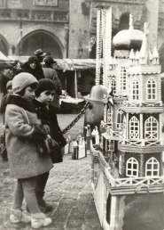
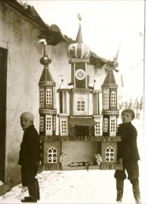
Crakow crib

Slide 6
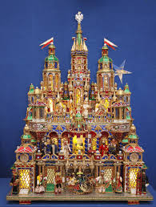
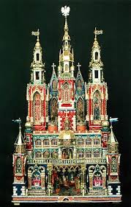
Cracow crib
People who make cribs meet in the park near Adam Mickiewicz monument to show their cribs, Then the best crib is chosen by the jury. The winner gets some money.

Slide 7
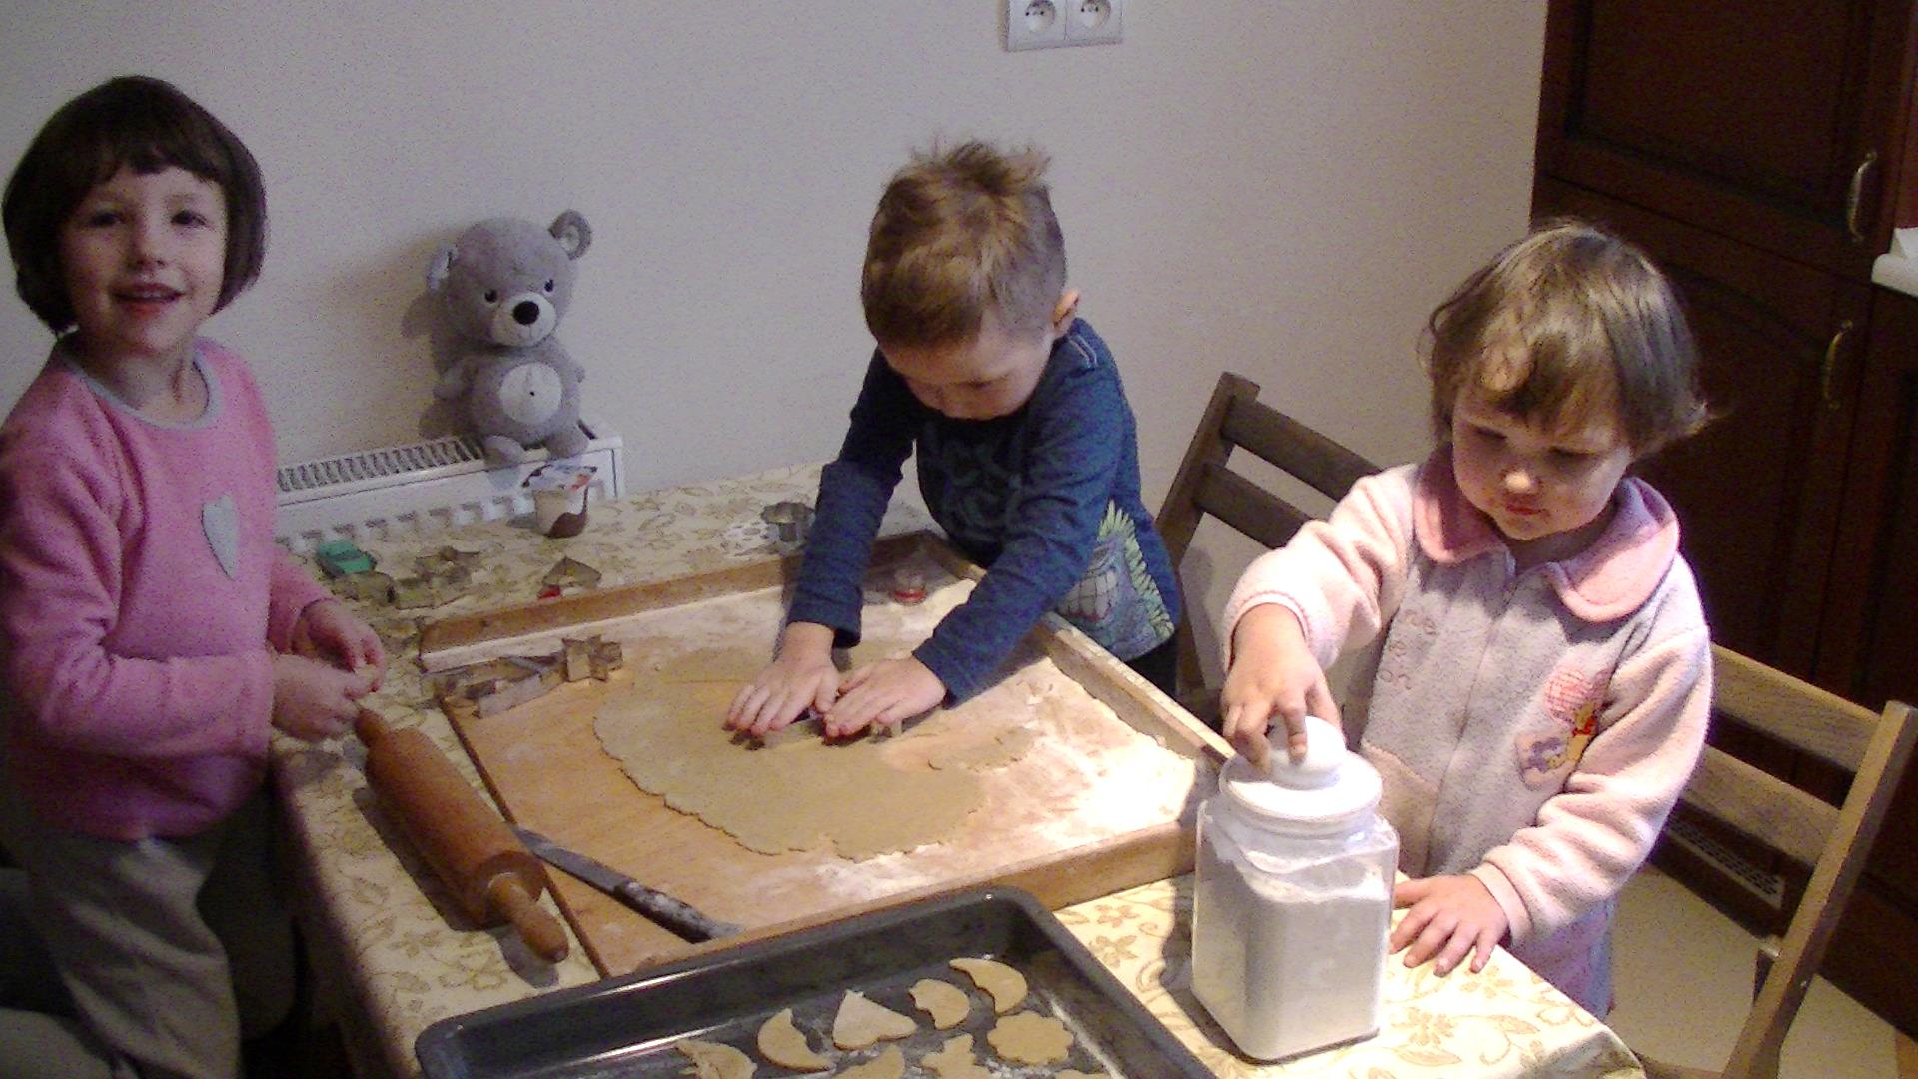
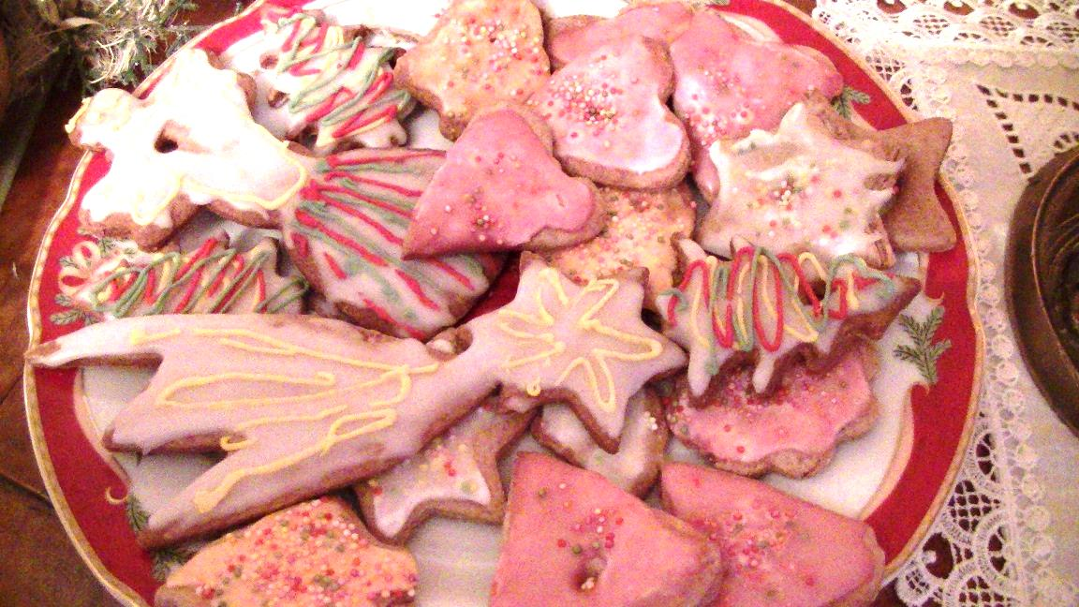
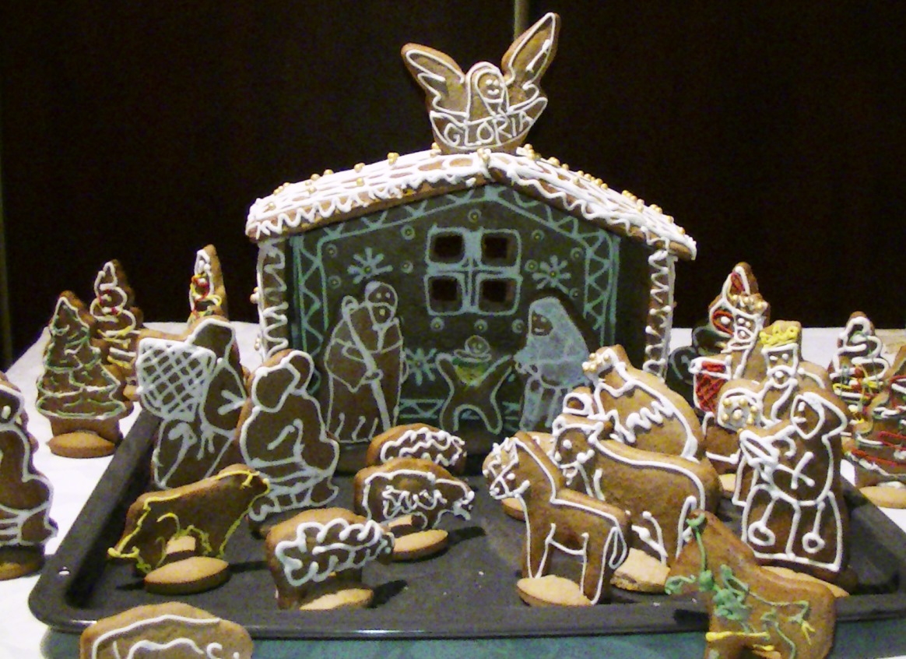
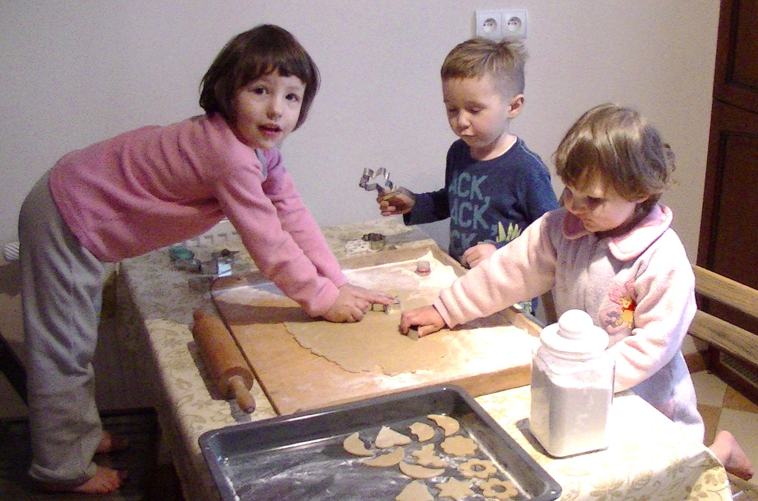
Gingerbread cookies
Many families bake gingerbread cookies before Christmas. They are hard and have different shapes. They may be covered with icing.

Slide 8
Christmas EVE

Slide 9
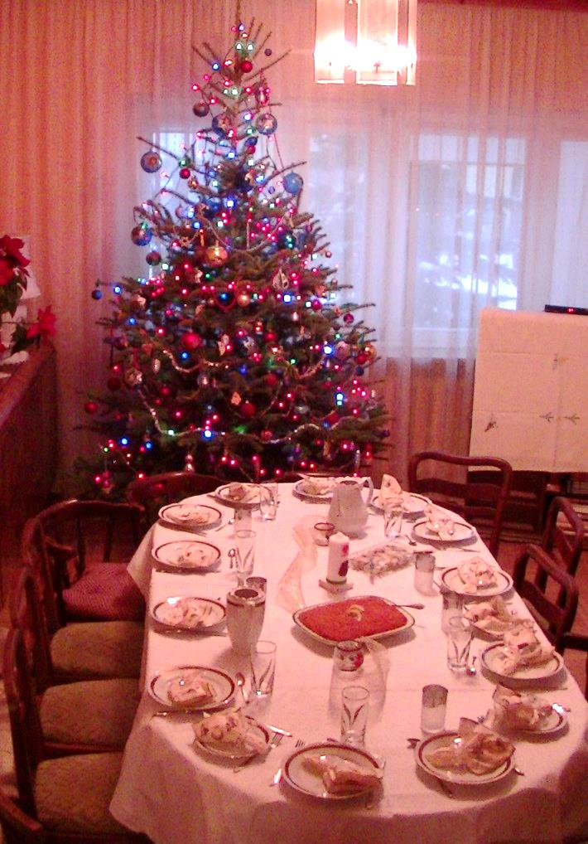
TABLE SETTING
The table is covered with a white tablecloth and some hay is spread under it. We leave an empty place at the table for an unexpected guest.

Slide 10
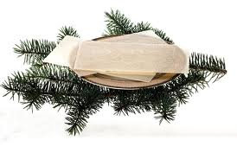
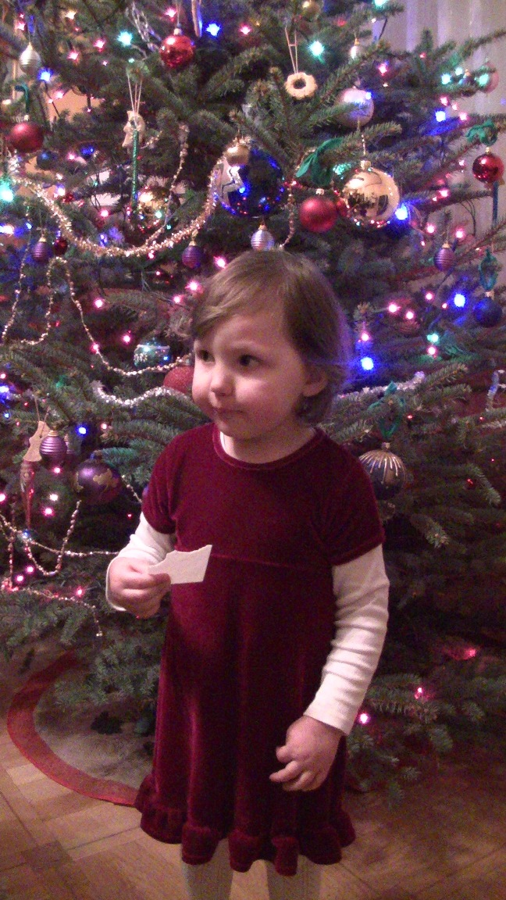
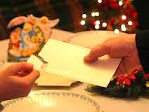
HOLY WAFER
Before we start eating, we share the holy wafer and wish each other all the best.

Slide 11
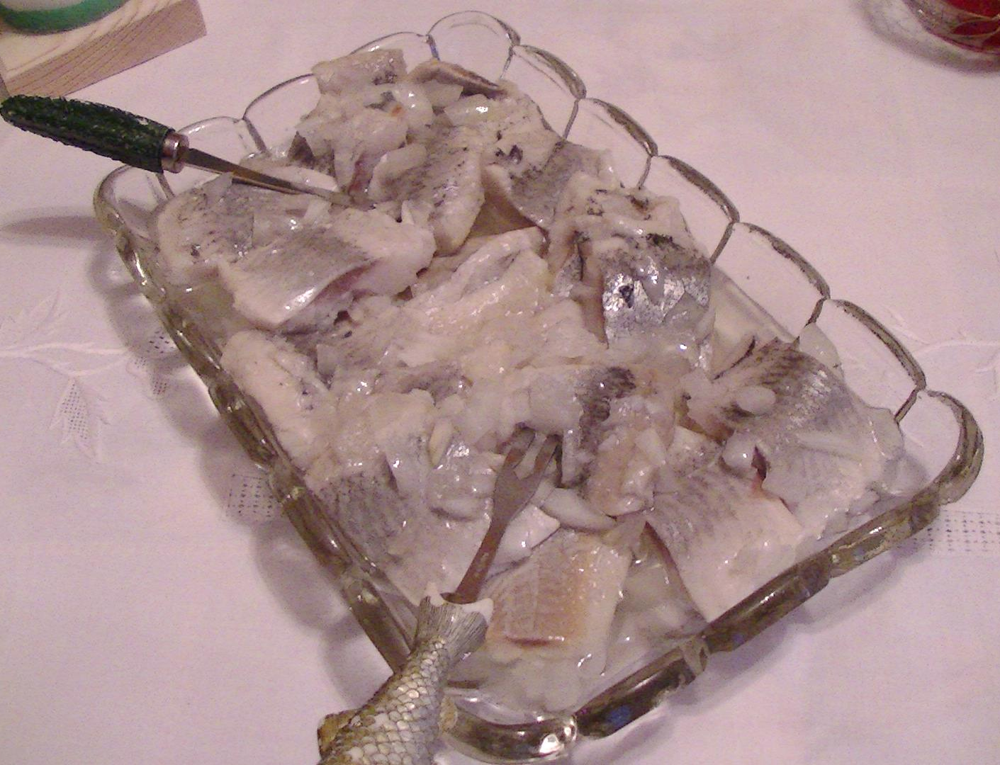
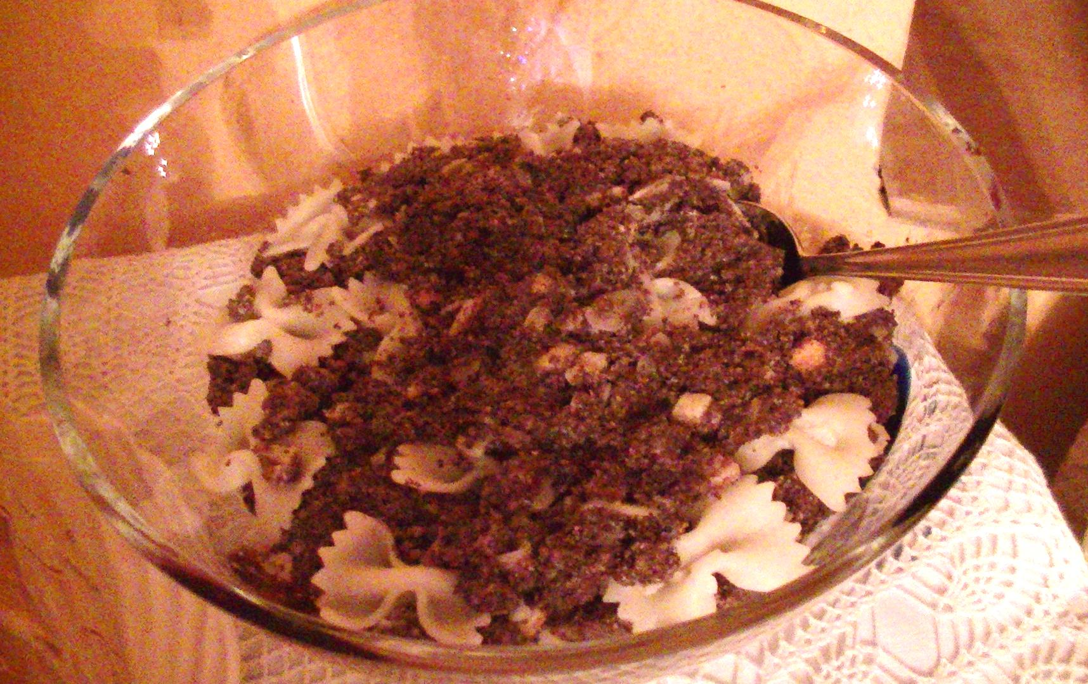
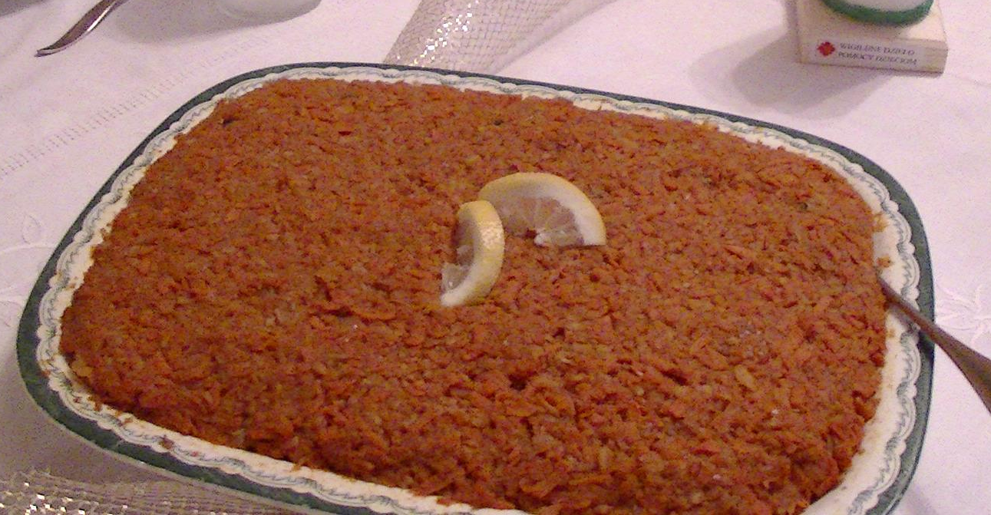
Typical Polish food
for Christmas Eve
There are 12 dishes on the table. You should taste all of them so the new year will be lucky.
We eat red borscht, dumplings stuffed with cabbage and mushrooms, fish fried or in aspic, carp, kutia, bigos, poppy-seed cake, cheesecake.
Traditionally, people eat
non-meat dishes.

Slide 12
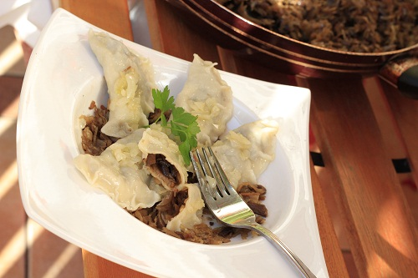
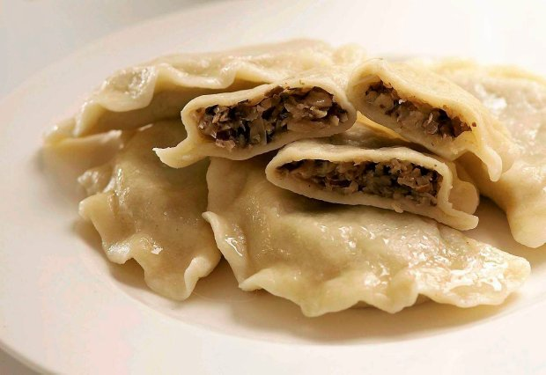
The most delicious ones are really tiny. They need to have a lot of dried mushrooms to have a suitable taste.
Dumplings with cabbage and mushrooms

Slide 13
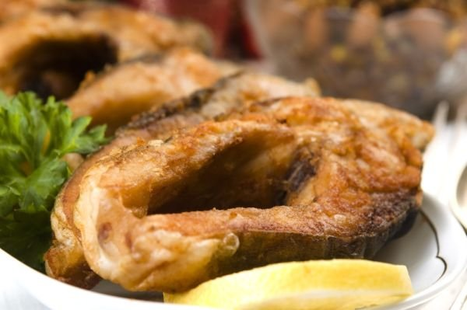
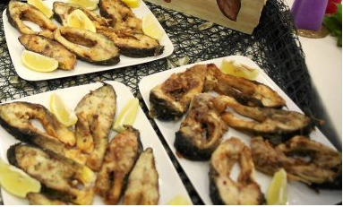
Fried carp
The properly grown carp has delicate and sweetish meat. Otherwise the fish smells like a mule. In some families the carp is fried, in others it is prepared in aspic.

Slide 14
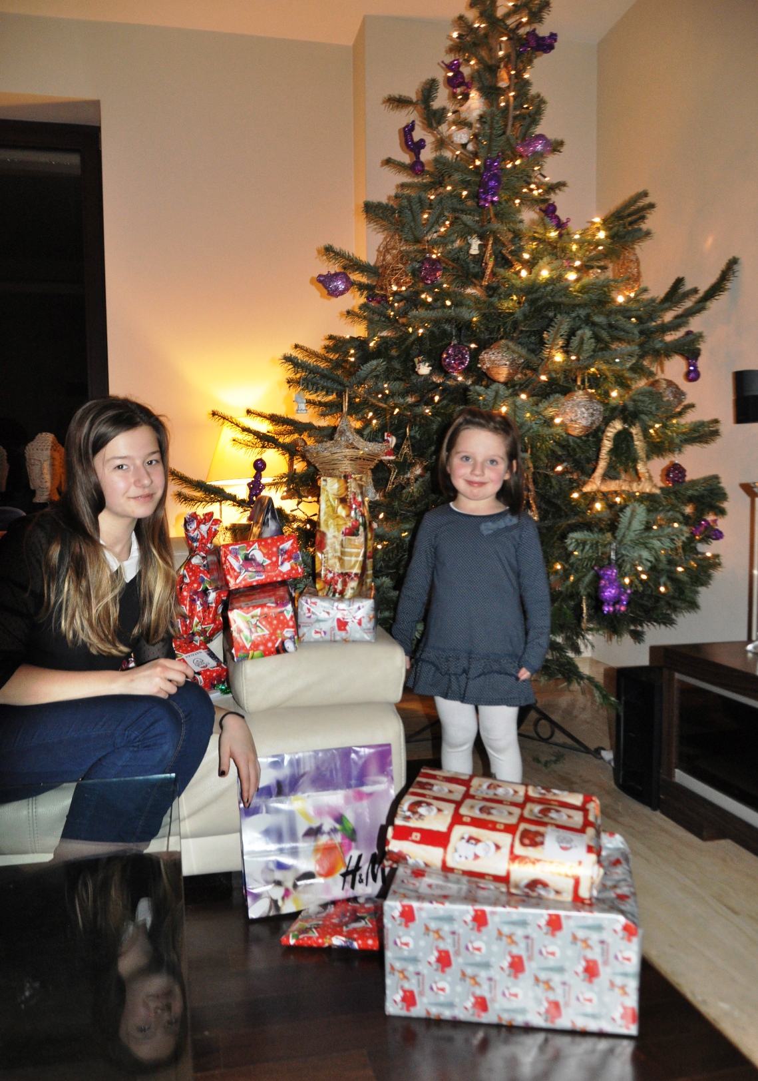
PRESENTS
On Christmas Eve when the first star appears Santa Claus puts presents under the Christmas tree. Presents are for good children only.
Everybody loves this moment of Eve.

Slide 15
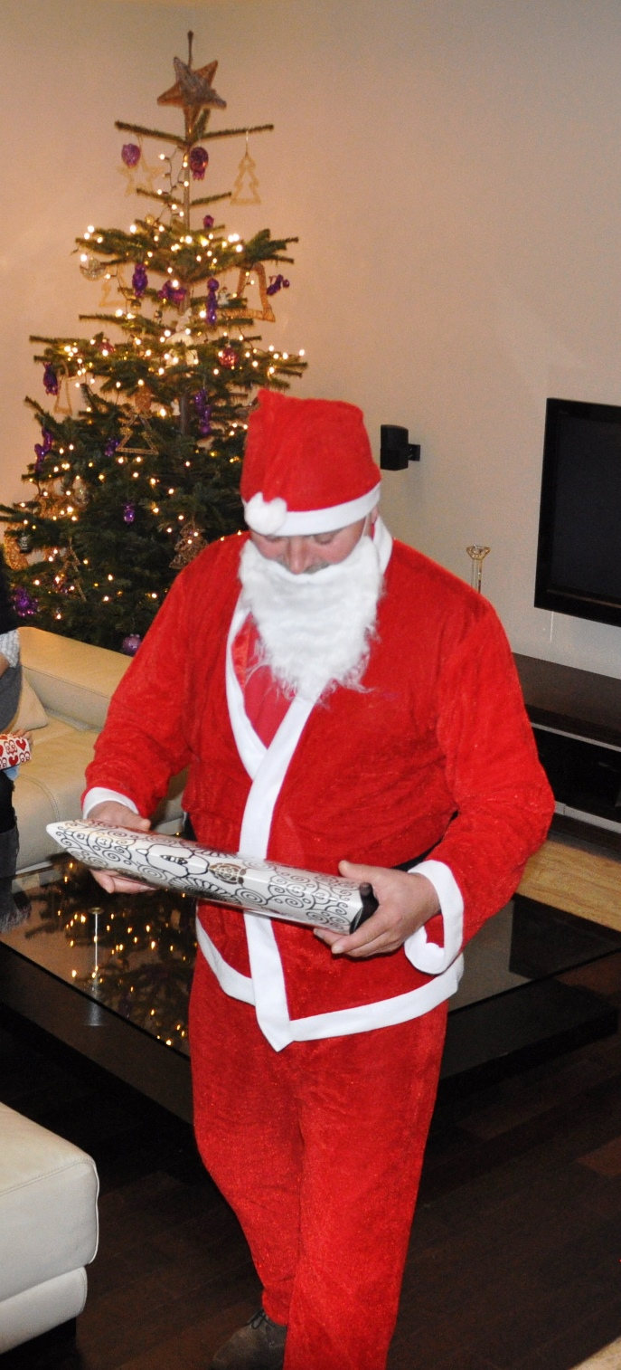
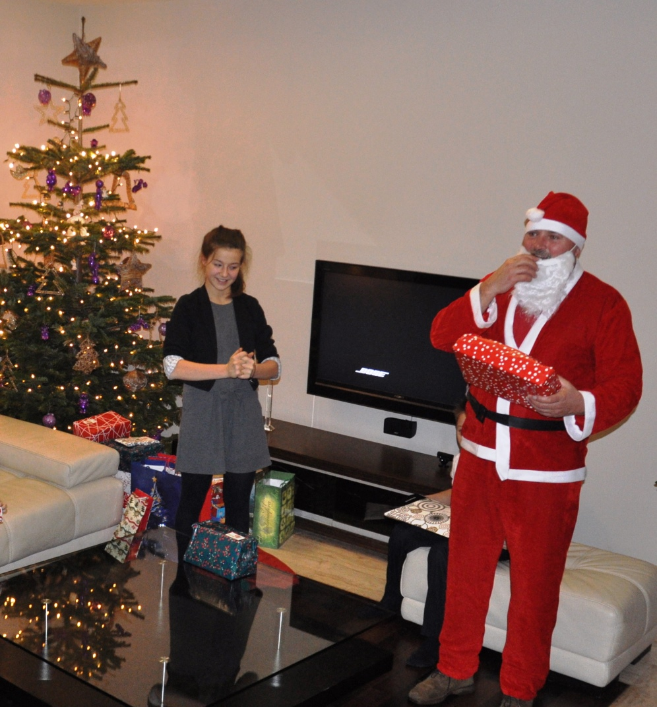
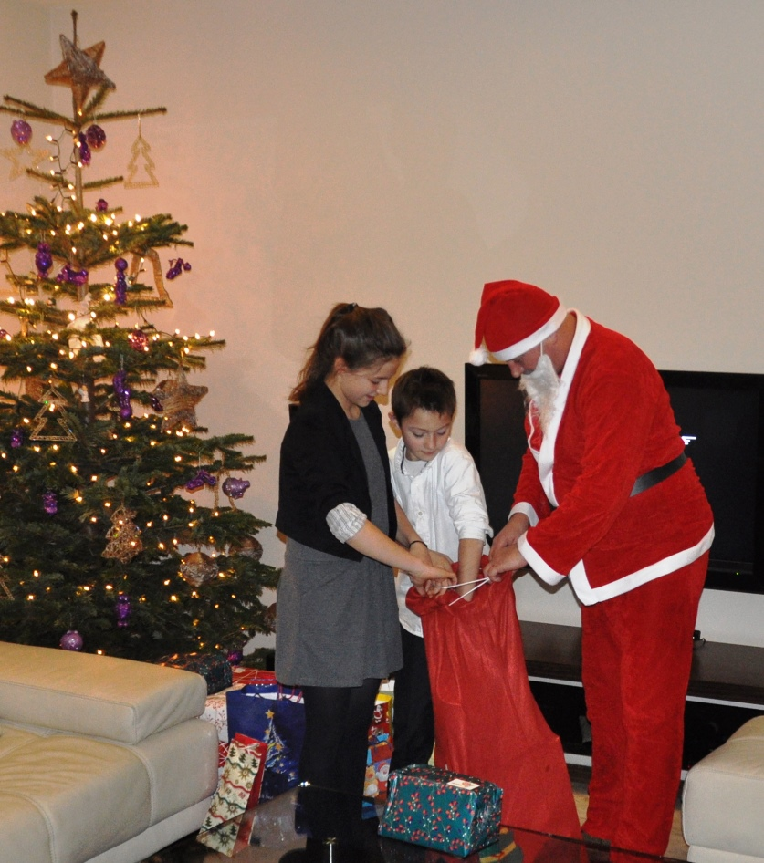
SANTA CLAUS
The old man called Santa Claus or Father Christmas comes to people and gives them presents on Christmas Eve.
Santa Claus from Mira was bishop who helped poor families.

Slide 16
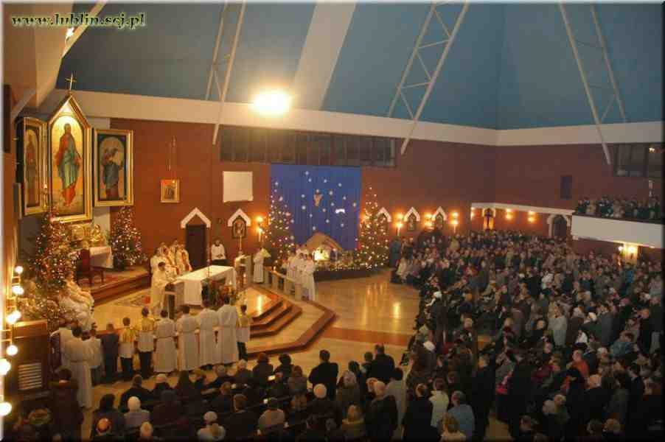
MIDNIGHT MASS
In Poland the Midnight Mass is one of the most important Christmas celebrations. It takes places on the night of 24-25th December at midnight. The Mass is to commemorate the birth of Jesus and the shepherds who went to Bethlehem.

Slide 17
Christmas TIME

Slide 18
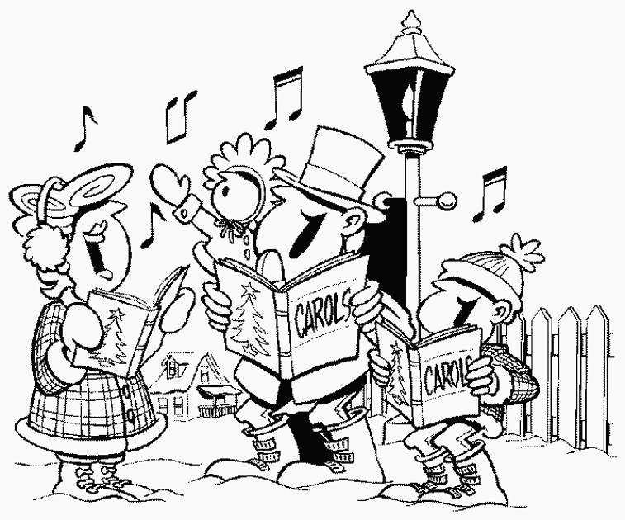

CHRISTMAS CAROLS IN POLAND
Singing Christmas carols at Christmas
time is very popular in Poland.
The most famous Christmas carols in Poland are:
Silent night (Cicha noc)
Today in Bethlehem (Dzisiaj w Betlejem)
Shepherds ran to Bethlehem (Przybieżeli do Betlejem pasterze)
People often meet at church and sing together.
Singing Christmas carols is a very old
and important tradition in Poland.

Slide 19
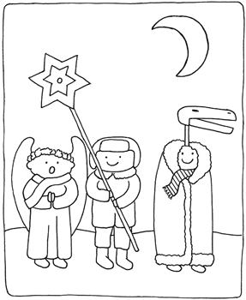
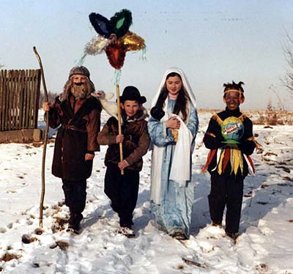
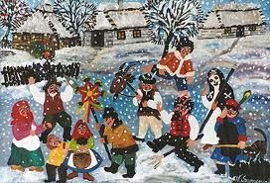
CAROL SINGERS
Carol singers visit people in some villages and sing carols. They wish us health, wealth and happiness, and are rewarded with candies, fruit or money.

Slide 20
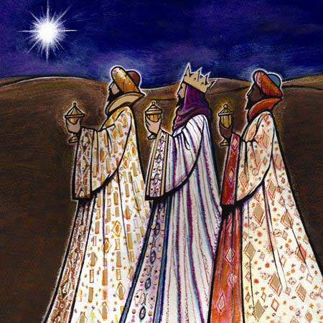
EPIPHANY
Polish people celebrate Epiphany on 6th January – the day when three kings came to Jesus and gave him presents - gold, incense and myrrh. People go to church and they have a day off at work.

Slide 21
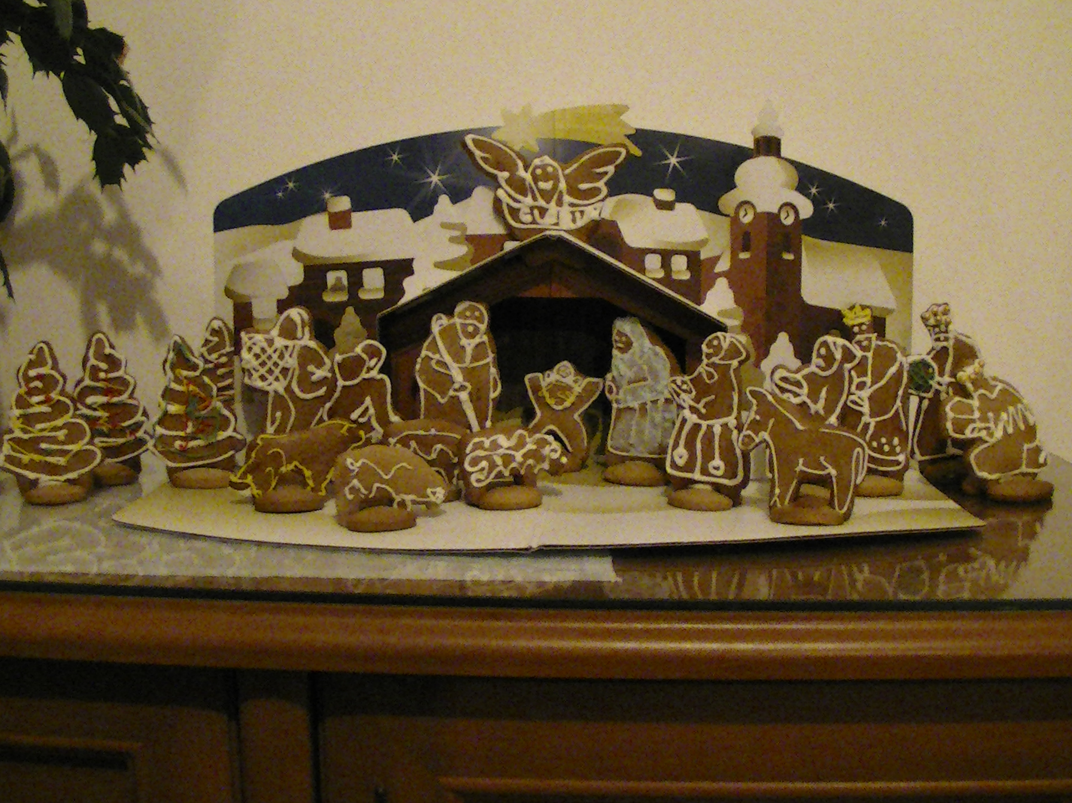
CREATED BY:
Slides
Photos
Patrycja Peda
Tosia Tkaczyk
Mateusz Różycki
Karolina Smulczyńska
Joanna Janicka
Patrycja Peda
Monika Kukiełka
Internet
Zalesie Górne
2013
Merry Christmas!!!

