Slide 1
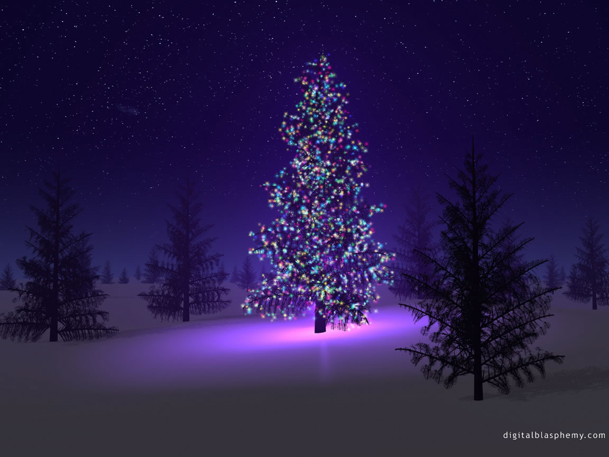

Celebrating Christmas in Slovenia

Slide 2
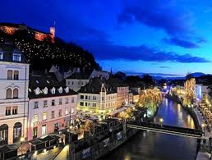
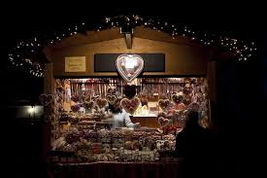
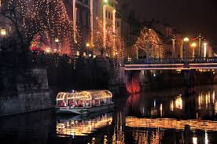
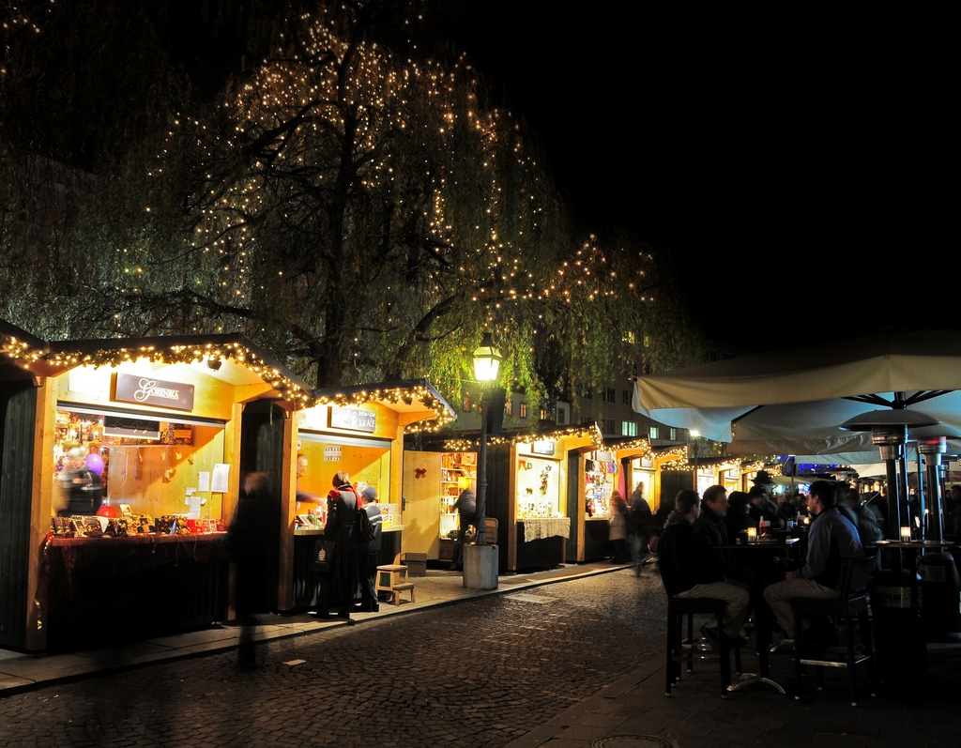
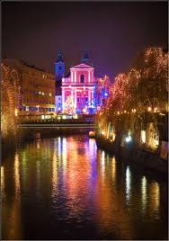
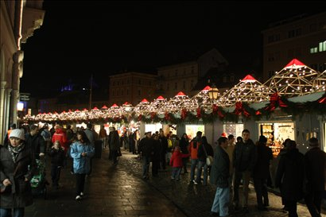
DECEMBER
In Ljubljana and other Slovenian towns there are stands which sell things like candies, winter clothing, food, jewellery and many other things throughout the whole of December.
And the whole city looks even more beautiful with little lights all along the river Ljubljanica.

Slide 3
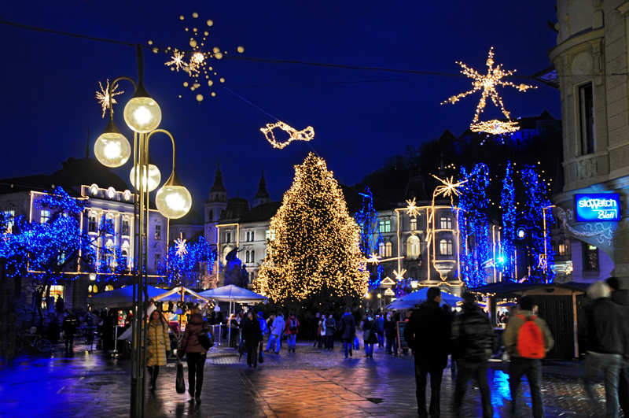
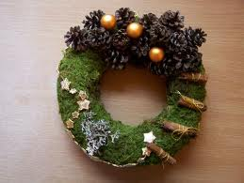
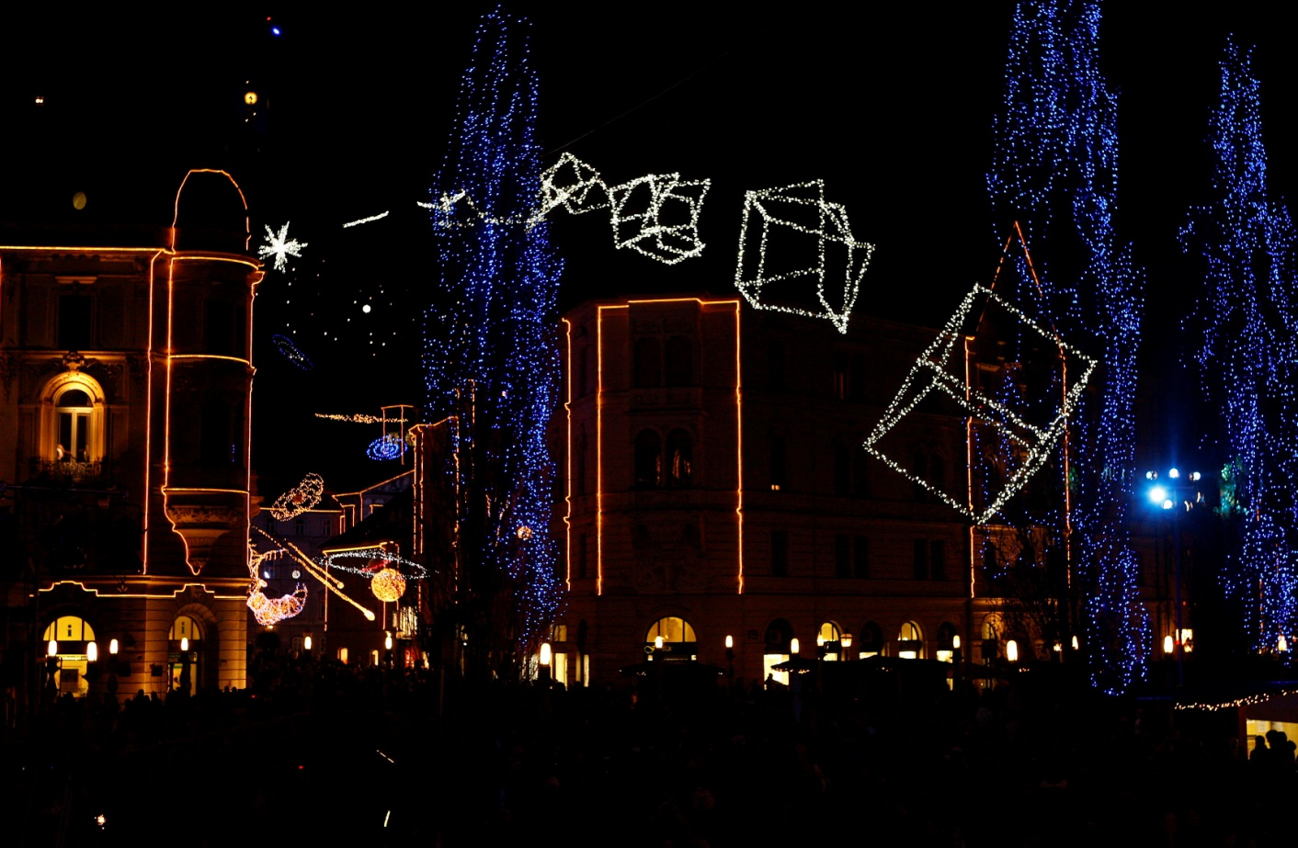
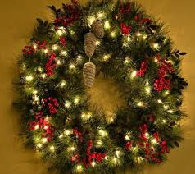
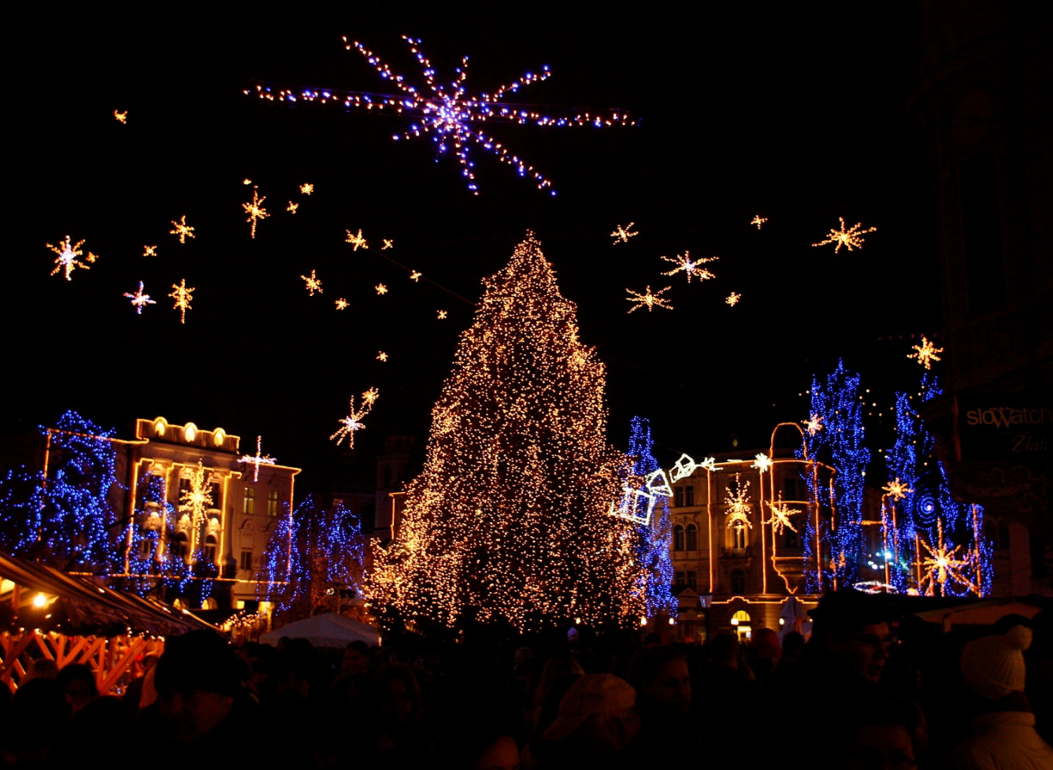
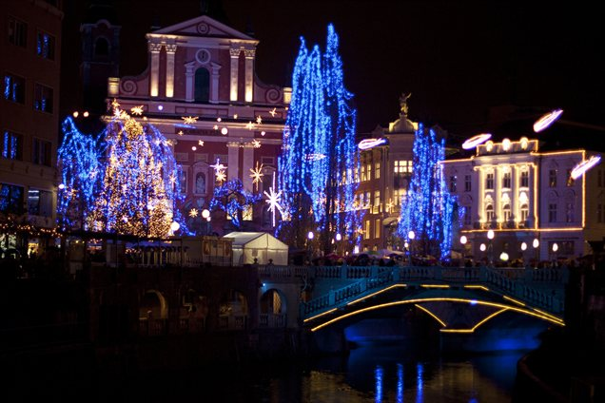
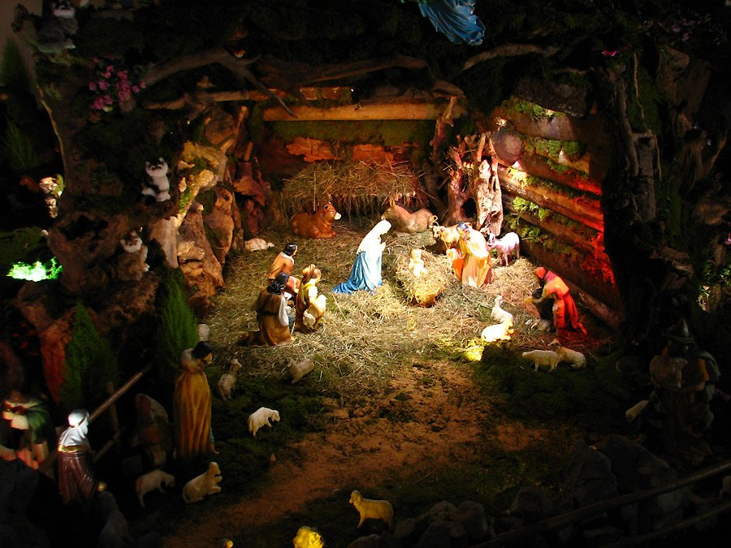
THE FIRST PREPERATIONS
The first preparations start already in late Novemer when they bring a huge Christmas tree to the capital. The tree and the sky are then decorated with lots and lots of little lights.
The families do the same in their homes. They decorate the family Christmas tree and make holly wreaths. Some even set up Christmas cribs.

Slide 4
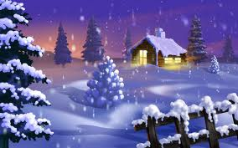
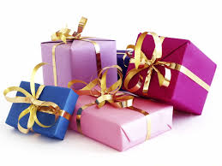
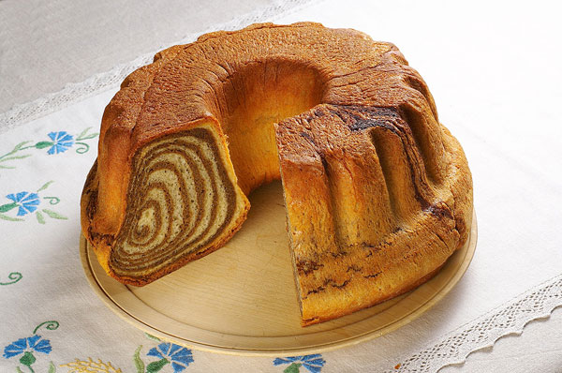
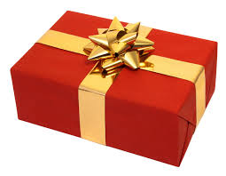
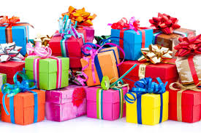
THE THREE GOOD men
Children receive gifts from three different men:
St. Nicholas called Miklavž in Slovenia
Santa Claus known as Božiček in Slovenia
And Father Frost or Dedek Mraz in Slovenian
In December we make a traditional dessert called potica.

Slide 5
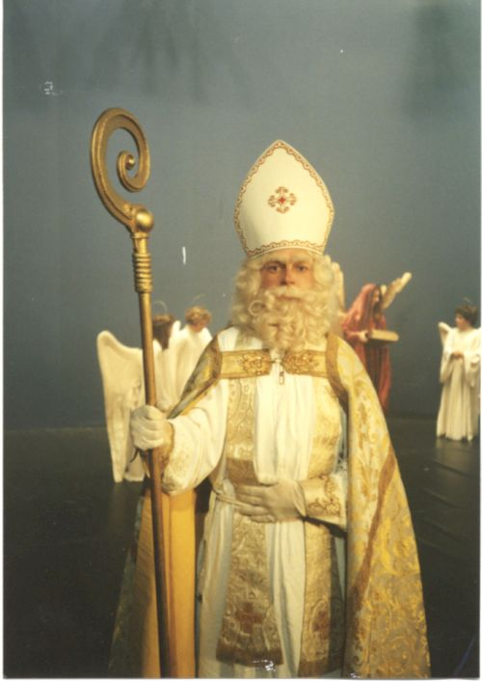
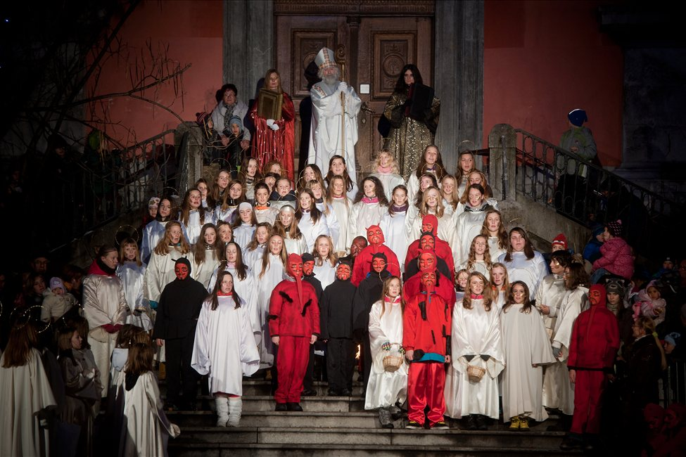
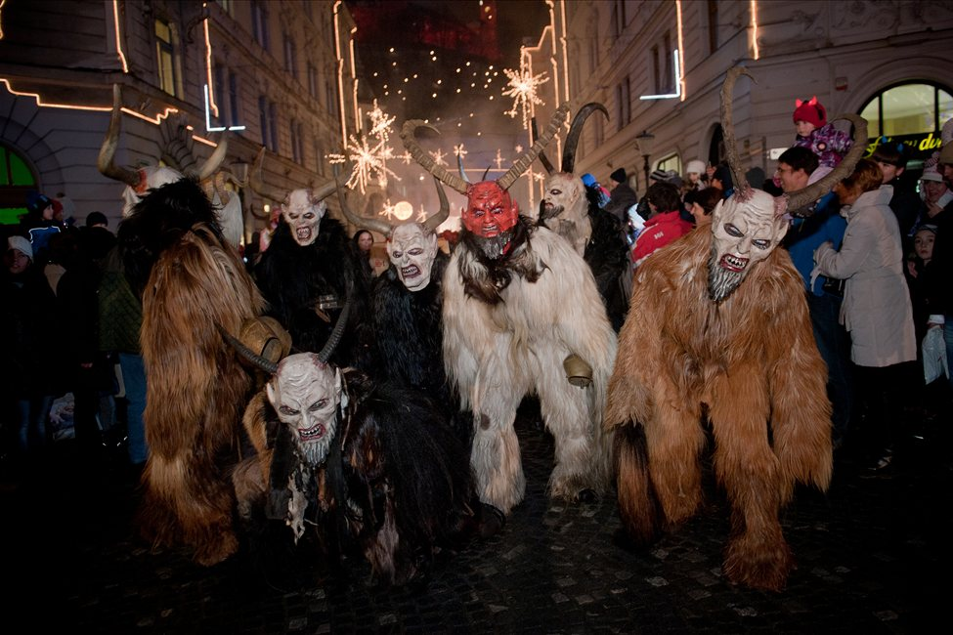
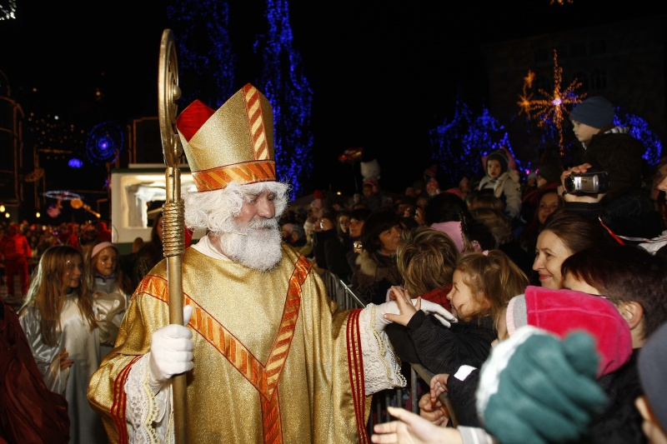
St.Nicholas-Miklavž
Every year Miklavž is welcomed by a procession of people.
He is always accompanied by the devils who scare little children, and the angels who sing to people. The angles arrive a few hours before Miklavž.
But in the evening of 6th December Slovenian children prepare the baskets for Miklavž to bring them fruits and candies.

Slide 6
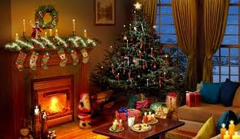
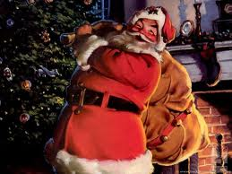
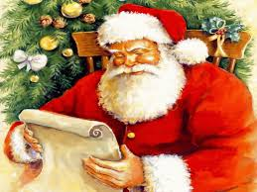
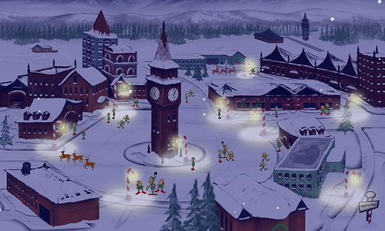
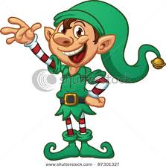
SANTA CLAUS-BOŽIČEK
Božiček comes on the eve of 24th December.
He brings gifts and leaves them under the Christmas tree.
Throughout the year, in the North Pole, elfs help him make all the toys and other gifts for children.

Slide 7
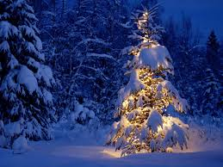
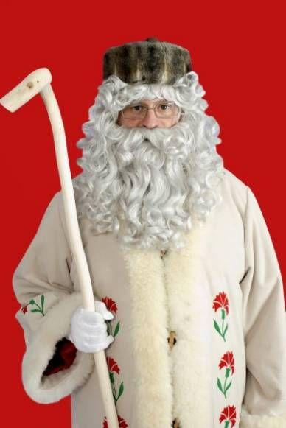
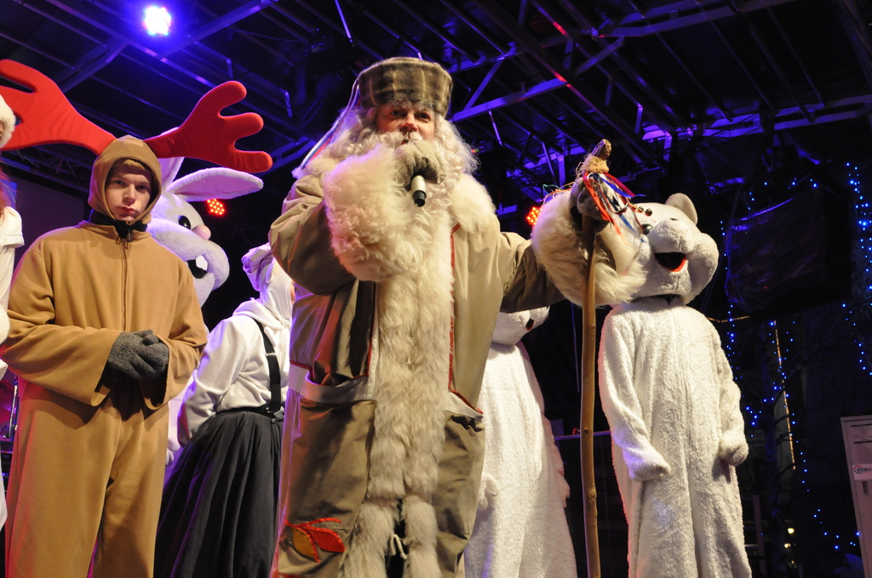
FATHER FROST-DEDEK MRAZ
We welcome him with a parade, and he comes here with all the animals that help him.
He visits our homes in the night on a New Years eve.

Slide 8
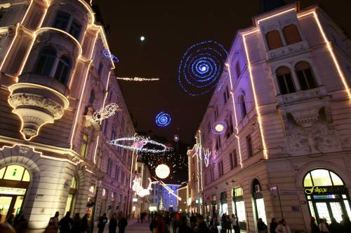
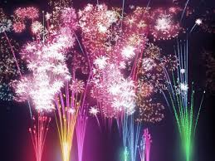
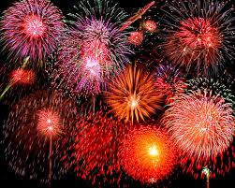
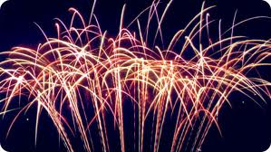
NEW YEAR
On the New Year‘s eve people usually stay up late like in every other country.
We hang out with people we love and spend pleasant time with them.
And when the clock strikes midnight people in Ljubljana gather on the Prešeren square and observe the magic fireworks display launched from the Ljubljana castle hill.

Slide 9

Lučka Gomsi 2.E

