Slide 1
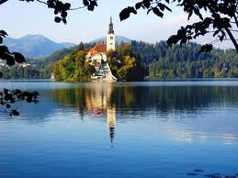
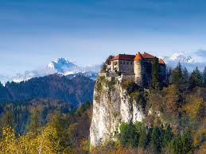
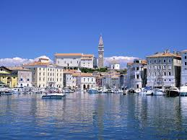
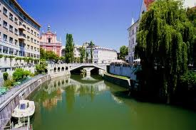
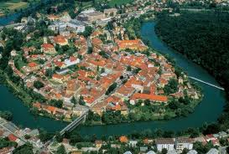
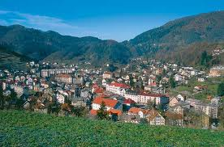
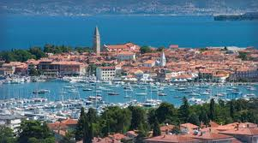
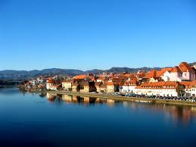
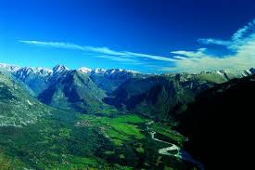
Spring Celebrations in Slovenia

Slide 2
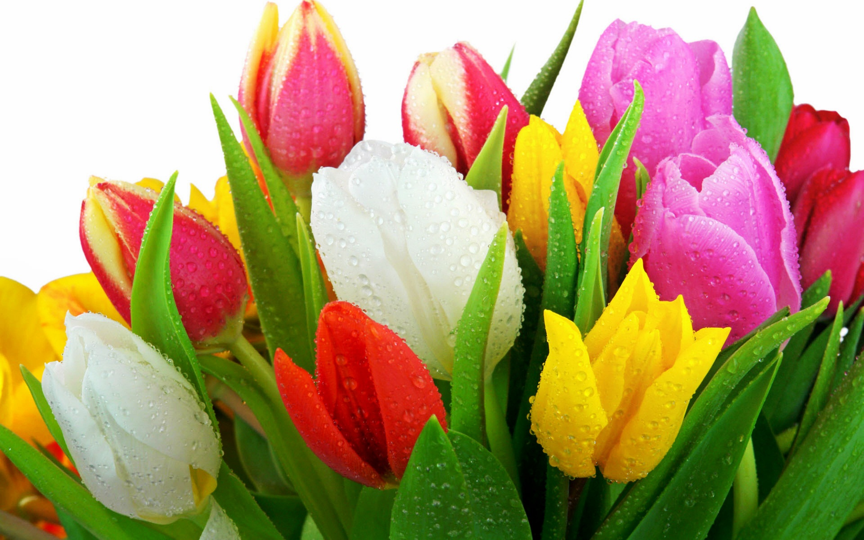
Spring provides us with fresh and vibrant colors, it brings new joy and new starts and also spring holidays.

Slide 3
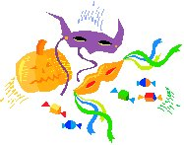
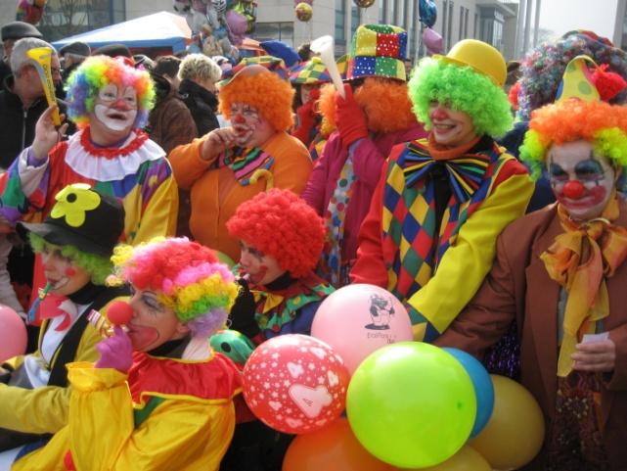
Pustovanje, Shrovetide Carnival
We say that Pust is a holiday of joy. Pust is supposed to drive winter away and bring spring to our land. For Pust people walk from house to house dressed in funny costumes. There are many old and interesting costumes, typical for certain regions such as Kurent for Ptuj and Laufar for Cerknica.

Slide 4
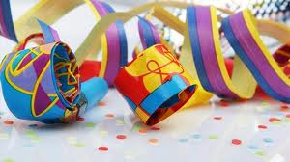
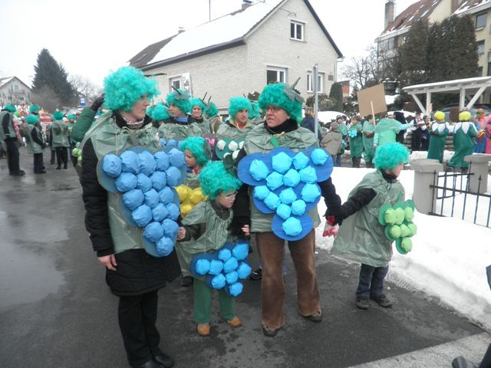
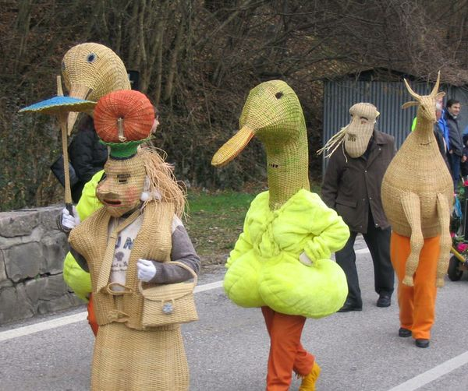
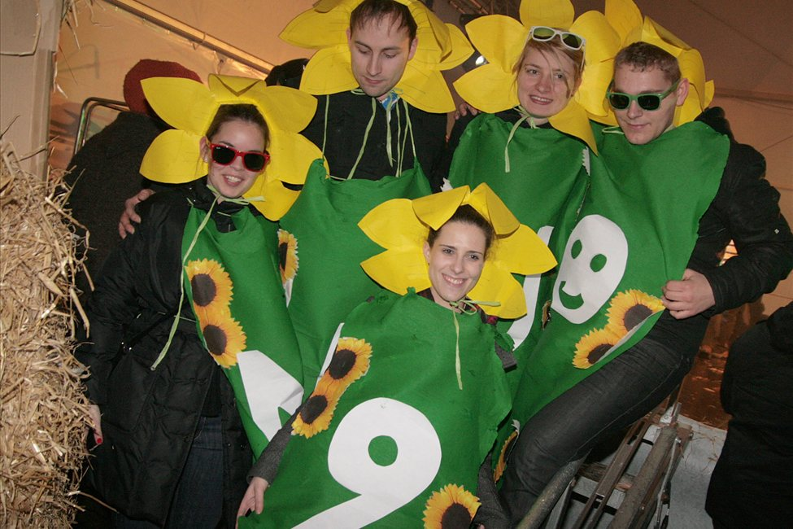
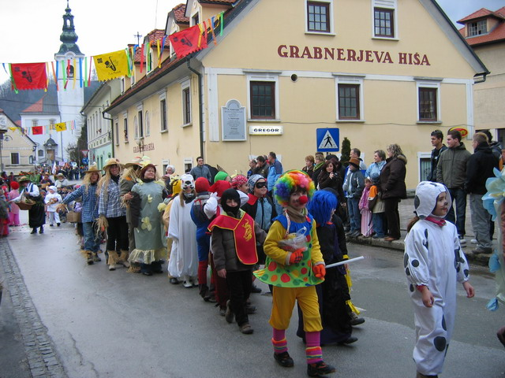

Slide 5
Pustovanje - Kurentovanje , Laufarji
This is an interesting carnival festival that takes place at the beginning of spring in the oldest Slovenian town Ptuj. The so called Kurenti wear massive sheepskin costumes and dance with the bells attached onto the chain around their waists. The noise of the bells chases winter away.
But in Cerknica we have Laufarji. Their masks are made of wood and differ a lot from Kurenti. Laufarija is a Shrovetide custom, also chasing winter away.

Slide 6
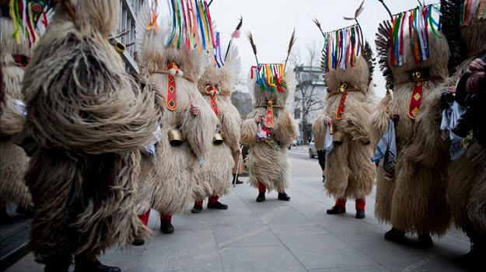
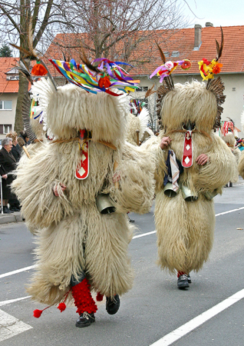
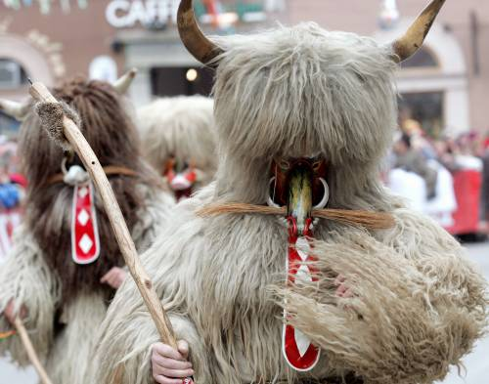
KURENT

Slide 7
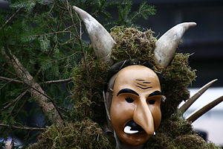
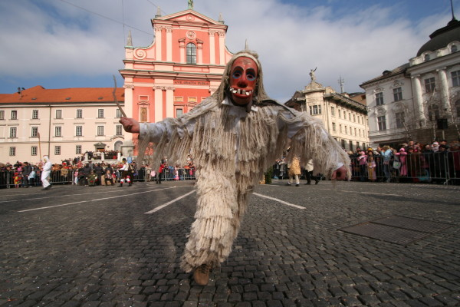
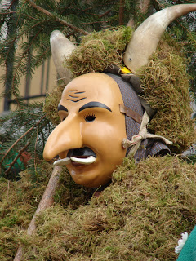
Laufar

Slide 8
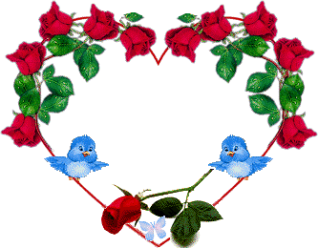
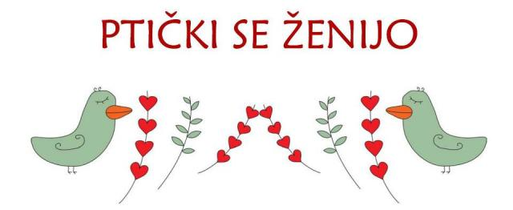
Gregorjevo, 12th March
Although Valentine’s day is known to be a holiday for lovers , Slovenia has its own version – Gregorjevo. Our grandmothers told us that on 12th March little birds were getting married. The old tradition says that girls used to look up at the sky on that day and the first bird a girl saw told her what kind of husband she would have.

Slide 9
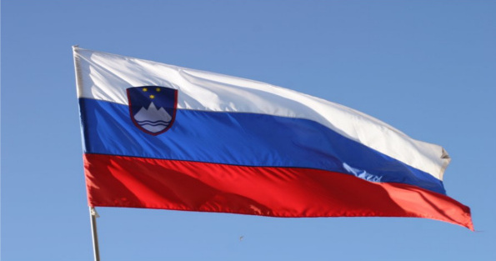
Day of Uprising Against Occupation
Resistance Day is a public holiday, which is celebrated on 27th April.
On this day in 1941 an anti-fascist and anti-imperialist Liberation Front was founded in Ljubljana.

Slide 10
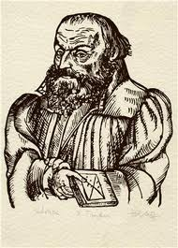
Day of Primož Trubar
8th June is commemorated in Slovenia as the Primož Trubar Day. It is a public holiday but not a day off.
Trubar was a Protestant reformer best known as the author of the first two printed books in Slovenian (Cathechismus and Abecedarium) in 1550.

Slide 11
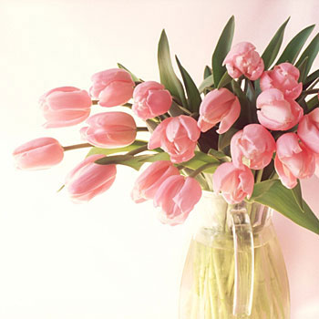
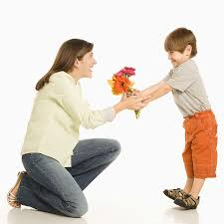
Mother’s day
Mother's Day is an informal holiday which honours mothers and motherhood, maternal bonds, and the influence of mothers in society. In Slovenia we celebrate Mother’s Day on March 25.

